Slide 1
Change Management Board Meeting
Tuesday, March 13, 2018
Audio: 1 (646) 749-3131,
Access Code: 671-865-437
Do NOT Put On Hold Call is Being Recorded
GoToMeeting:
https://global.gotomeeting.com/join/671865437

Slide 2
Welcome and Call for Quorum
Bryan Homayouni, P.E., CMB Chairman

Slide 3
Agenda
Time | Item | Lead
1:30 – 1:35 | Welcome and Call for Quorum | Bryan Homayouni
1:35 – 1:45 | Previous Meeting Recap & Action Item Review | Bryan Homayouni
1:45 – 2:05 | SunGuide Software Update | Derek Vollmer
2:05 – 2:25 | SunGuide and ICMS Integration (vote) | Clay Packard
2:25 – 2:35 | RPG to Remove Error and Out of Service DMS – 3747 (vote) | Derek Vollmer
2:35 – 2:45 | Cloned ‘Disabled Vehicle’ Created as ‘Abandoned Vehicle’ – 3751 (vote) | Derek Vollmer

Slide 4
Agenda
Time | Item | Lead
2:45 – 3:05 | Updated Probe Detector Specifications | James Whitley, Derek Vollmer
3:05 – 3:25 | Open Discussion | Bryan Homayouni
3:25 – 3:30 | Review Action Items | Bryan Homayouni
CMB Agenda, slides, and attachments posted here:
http://www.dot.state.fl.us/trafficoperations/ITS/Projects_Deploy/CMB.shtm

Slide 5
Previous Meetings Recap and Action Items Review
Bryan Homayouni, P.E., CMB Chairman

Slide 6
Previous Meeting Action Items
Owner | Action Item
Derek Vollmer | Add footprint 1685 to the SSUG meeting.
Derek Vollmer | Add RWIS to the SSUG meeting.
Derek Vollmer | Work on Concept of Operations for the Executive Notifications.
Derek Vollmer | Provide the dates for the next releases of SunGuide.
Derek Vollmer | Update the CMB process document the voting requirements section.
Derek Vollmer | Keep the Districts in the loop on the architecture update process.
Derek Vollmer | Send Eric Gordin the screen capture of the event headers.

Slide 7
Previous Meeting Action Items
Owner | Action Item
Derek Vollmer | Send out the online vote for the event headers.
Jeremy Dilmore | Send information to Derek on the Roadway naming after receiving DTOE feedback.
Chester Chandler | Reach out to Alan El-Urfali about the RWIS developmental specification.

Slide 8
SunGuide Software Update
Derek Vollmer, P.E., FDOT

Slide 9
SunGuide Software Update
Release 7.1 – released on Tuesday March 13, 2018
Developing Training slides
District 2 takes a leap of faith
Installed 7.1 week of March 5th
Discuss any issues discovered with the upgrade

Slide 10
SunGuide Software Update
Release 7.1.1 testing on March 16th
Includes 3808 Add Lane by Lane Detector Data
2736 Links on map part 1
3873 Traffic Signal Malfunction
3849 Add roadway type flags to roadway definitions
3984 Match Bluetooth reads between all makes/models
Early May release
Could be earlier, but this is our first small release

Slide 11
SunGuide Software Update
What we currently have approved for 7.1.2
SG 3855 Include Travel Time Destination in DMS Message Report
SG 2507 Display Coordinates vs actual coordinates
SG 4181 Update Connected Vehicle Protocol
May have issue testing this. Need to find out what hardware we have available and what software version they have
SG 3881 Toggle Between Multiple Video Streams in VOD
August 2018 release timeframe

Slide 12
SunGuide Software Update
What we currently have approved for 7.2.0
SG 3848 Change how roadways are handled
SG 3860 Planned events
SG 2963 Case Insensitivity
SG 1422 Audit Chronology
SG 3568 Monitor and regulate DMS Fonts
SG 2736 Links on map part 4 (hover spread)
Anticipated release in February 2019
Want to try and include executive notifications
If we can get intersections included, this date will need to change

Slide 13
Intersections in SunGuide
Requested by District 2 for intersection EM Locations
Currently enter multiple events in SunGuide for crashes at a signalized intersection
Creates issues with performance measures (number of events)
Time consuming to enter
Up to four events will appear on FL511 for one event

Slide 14
Intersections in SunGuide
Create a new EM location type for intersections
Can have multiple roadways
This is for crashes in/at the intersection
Still need locations for the approaches

Slide 15
Intersections in SunGuide
Locations configured with lane mapping of all approaches
HERE map data provides a lot of this information
HERE map data is missing intersections (identified as signalized)
Has a lot of signalized intersections in the data
Want to prepopulate lane mapping configuration using HERE data

Slide 16
Intersections in SunGuide
Keep track of lane blockages at the intersection
Send lane blockage information to DIVAS to send to third parties
FL511 would say “Crash at intersection of Road1 and Road 2, expect delays”
This is roughly where we are with this one

Slide 17
Executive Notifications
Draft ConOps available for review and comment on external sharepoint site
Proposed manual trigger (exec notification comment type) for:
More than 5 fatalities – D2 comment to add “Greater than 5 fatalities” injury type to help automate
Fatality or injury to FDOT employee/contractor performing work along the roadway
Multi vehicle crash where smoke is involved – D2 comment to autotrigger if you associate a visibility event to a crash.

Slide 18
Executive Notifications
For Bridge closures/failures, proposing a new event type called Bridge closed with SAE code 26 for Bridge closed
Definition of bridge includes overpasses.
Is SAE for “Bridge closed” the best option?
Should we just say road closed?
Still have Bridge Closed event type in SunGuide?

Slide 19
Executive Notifications
District 7 would like to propose adding images to executive notifications.
Let’s discuss

Slide 20
Truck Parking
Drivers tested for Sensit and Sensys
Configuration clarification needed for this
Released driver for Sensit
Sensys tested and passed, release soon
Developing a driver for Civic Smart

Slide 21
Truck Parking New Needs
Multiple zones or parking rows with DMS in the rest area
Ability to know when the space becomes occupied and someone leaves…turnover per space
Posting zero vs low
Investigate maintenance information?
Battery life
Individual detector status (working or not)

Slide 22
QUESTIONS?
Derek Vollmer, P.E., FDOT
Derek.Vollmer@dot.state.fl.us

Slide 23
SunGuide and ICMS Integration
Clay Packard, P.E., VHB

Slide 24
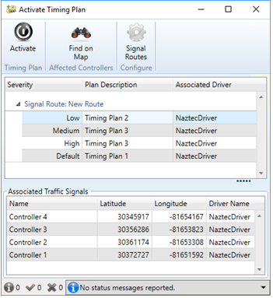
Overview
Similar to D2’s Signals in SunGuide just released
Enhancement to improve computer decision accuracy via real-time analytics
Real-time traffic intersection data available – TMCs
Online simulation capable of real-time forecasting of outcomes for multiple signal timing scenarios
External system – Regional Integrated Corridor Management System (R-ICMS)
Collects data, Performs analytics, Coordinates agency approval
SunGuide system
provides event management functionality
actives diversion route

Slide 25
Why R-ICMS?
Predict the measures of effectiveness (MOE) 30 minutes into the future
Expected benefit to the roadway network is quantified prior to making a change, and
so that changes are compared with alternative changes and with the no-change scenario.
Determine which response plan is predicted to achieve the highest MOE
Determine if not using a response plan is preferable due to lack of MOE
Determine when a diversion route response plan is no longer needed and no longer provides a benefit

Slide 26
Why SunGuide?
SunGuide already manages traffic events and response plans.
SunGuide already manages and integrates with traffic control devices and systems.
Thus, most efficient approach is to pass R-ICMS recommendation to SunGuide
Notes:
Avoid redundant event management systems with overlapping functions
Avoid multiple systems integrating with devices

Slide 27
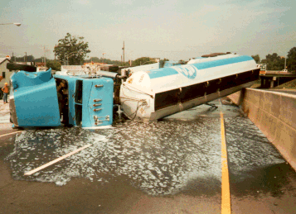
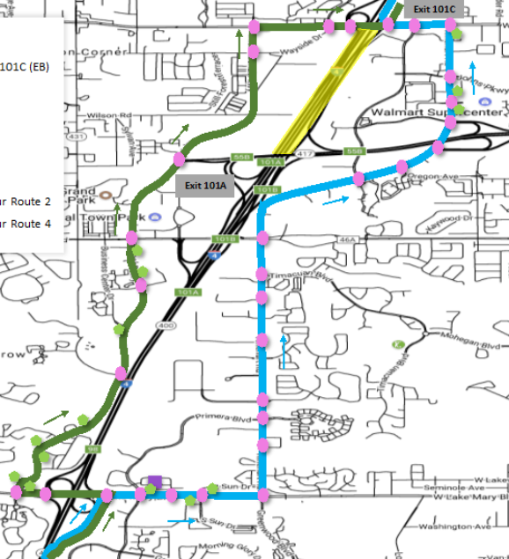
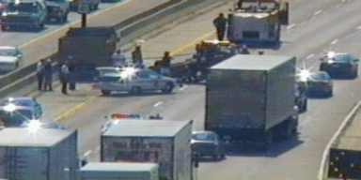
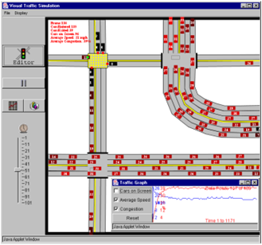
ICMS Operations
Data Fusion Environment
Response Plan
w/ Diversion Route
Incident Detection
Mesoscopic Simulation for
Realtime 30 Minute Forecasting
Signal Timing
Plan Selection and
Optimization
Notes:
The R-ICMS System’s Mission is based on a couple of operational processes
Operational Processes:
1. Data Collection, from numerous sources
2. Incident Detection and Response:
Detect incidents or, how do we say it nicely, opportunities for improvement in the transportation network, specifically
non-recurring congestion on freeways and arterials
Recurring congestion in arterials
Develop a diversion route response plan
Use as many available resources, controls, and levers as we can
traffic signal timing changes “flush plans” along adjacent corridors
Connected Vehicle Traveler Information Messages,
DMS, 511, and all other info dissemination channels
Ramp Metering (future)
Hard shoulder running (future)
Managed lanes pricing deactivation (future)
3. Signal Optimization Tool – ran out of space for graphics on this slide so, we’ll cover that later

Slide 28
Users/Stakeholders
Traffic Management Center (TMC) SunGuide Operator: This person is responsible for managing ITS devices and events, and for operating the SunGuide software.
Traffic Management Center (TMC) Manager: This person is responsible for overseeing the systems and managing the operations staff at the TMC. This person is not required to be a professional engineer.
Traffic Management Center (TMC) Corridor Manager: This person is responsible for managing the corridor operations, is physically located at the TMC, and is operating the R-ICMS user interface software. This person is typically a SunGuide software operator. There will typically be one TMC corridor manager per county, with Orange county having one TMC corridor per distinct ATMS system.
Traffic Management Center (TMC) Arterial Manager: This person is a traffic engineer with a professional engineering license. This person responsible for managing the arterial roadway and can make timing plan adjustments and sign and seal the adjustments.
Maintaining Agency Traffic Engineer: This person is a traffic engineer with a professional engineering license. This person is responsible for maintaining the traffic signal systems, including the traffic signal timing plans. This person will review diversion route recommendations and approve them if they are acceptable in their engineering judgement.

Slide 29
Non-Recurring Congestion Workflow
ICMS
SunGuide

Slide 30
Diversion Route Recommendation
Design Time:
Repository of Response Plans having Diversion Routes
Rules engine mapping event attributes to response plans
Run-Time:
Rules Engine Selects response plan for active incident
Mesoscopic simulation engine predicts measures of effectiveness 30 minutes into future
Operator and Agency Approval obtained prior to activation
Notes:
Let’s Quickly drill into the First Operational Process – Incident Detection and Response
Design Time –
this was one of the separate building blocks
we contracted with Kapsch for them to do since their team built the ICMS-like systems in San Diego and Dallas
What they did was – (see slide)
Run-Time –
You can see the workflow at the bottom of the slide (talk through the steps)
The Recommended Diversion Route is where the intelligence happens
Fully vet the proposed response plan before activation

Slide 31
SunGuide Software Changes Needed
Accept incoming R-ICMS Response Plan Recommendations
Present R-ICMS Response Plan Recommendation to Operator
Incorporate R-ICMS Response Plans into EM Event Response Plans
Interface with traffic signal ATMS
Multiple vendors: Econolite Centracs, Trafficware ATMS.now, Seimens Tactics, potentially Intellight
Retrieve operational status, timing plan information, and activate alternate timing plans
Deactivate alternate timing plans – i.e. back to normal time of day operations
Status and Performance monitoring and reporting

Slide 32
Cost & Schedule
Assumptions
4 new drivers (3 TCS, 1 IDS)
Signal Vendors will have to provide an API
Mods to Operator Map, IDS, Database, TCS, EM
“Merge” response plan functionality will need to be well defined have several design reviews.
Level of Effort
$105k
Timeline:
7.2

Slide 33
QUESTIONS? (VOTE)
Clay Packard, P.E.
Clay.Packard@dot.state.fl.us
Jeremy Dilmore, P.E.
Jeremy.Dilmore@dot.state.fl.us

Slide 34
RPG to Remove Error and Out of Service DMS – 3747 (VOTE)
Derek Vollmer, P.E., FDOT

Slide 35
RPG to Remove Error and Out of Service DMS – 3747
Goals:
Faster activation of response plan
Better visibility in Chronology for signs that didn’t post due to Error or Out of Service
Proposal
Leave Error and Out of Service signs in the response plan. Allow EM to send to these signs as normal.
This would also allow signs in the Error state to potentially post the message if they become Active
Chronology entry for Error and Out of Service signs would note that the message was sent, but would also note the state of the sign and say the message will not post.
New Chrono type

Slide 36
Cost & Schedule
Estimate: $1.5k
Schedule Release: 7.1.2

Slide 37
QUESTIONS? (VOTE)
Derek Vollmer, P.E., FDOT
Derek.Vollmer@dot.state.fl.us

Slide 38
Cloned ‘Disabled Vehicle’ Created as ‘Abandoned Vehicle’ – 3751 (VOTE)
Derek Vollmer, P.E., FDOT

Slide 39
Cloned ‘Disabled Vehicle’ Created as ‘Abandoned Vehicle’ – 3751
Goals:
Change Event Type of a Cloned Event before creating the new event
Proposal
Allow a configuration in the config file that allows the user to set up event type transitions for cloned events. (Event Type X -> Event Type Y)
Create a dialog pop up when cloning an event that would allow you to change the event type to something else.
If a transition is configured in the config file, the right event type would be prepopulated
Popup can be the “Add New Event” Dialog with a new title
Fields Available
Event Type
Location
Agency/Contact
Event Status

Slide 40
Cost & Schedule
Estimate: $6k
Schedule Release: 7.1.2

Slide 41
QUESTIONS? (VOTE)
Derek Vollmer, P.E., FDOT
Derek.Vollmer@dot.state.fl.us

Slide 42
Updated Probe Vehicle Specifications
James Whitley
Derek Vollmer, P.E., FDOT

Slide 43
Probe Detection Specification
Specification 660 – Vehicle Detection Specification
Functional type is Probe Data Detection System
Technology type is Automatic Vehicle Identification (AVI)
660-2.1.2.5.3 Probe Detector Data Requirements
Number 2 is Bluetooth readers
This section is 2 sentences

Slide 44
Probe Detection Specification
Section 660-2.1.2.5.1 is configuration and management for AVI
Applies to all AVI, not just Bluetooth
Says the detection system is provided with software that allows local and remote configuration and monitoring
660-2.1.1.3 Probe Data Detection Systems
Says “The identifier is then transmitted to a central site…matched…”
Not much is required for Probe Data Detection Systems
There are performance requirements that discuss match rate greater than 5% and other performance requirements

Slide 45
Transportation Data and Analytics Needs
Needs to match the unique identifiers Statewide
If possible, could include local agency data for “last mile” bottlenecks and Origin Destination.
Looking to try and identify freight vehicles using multiple technologies.
Could share this data set with customers (MPOs, Planners)
Planners do not need real time data

Slide 46
Transportation Data and Analytics Needs
Weigh station staff investigating a through pass type system that uses Bluetooth and other identifiers to expedite freight movement.
This one uses real time data.
Will need their own Bluetooth detectors for this system

Slide 47
SunGuide Software Needs
Travel time algorithm can use tag matches
Some vendors provide tags
Encrypted
Truncated differently
Some vendors provide speed data only
May not provide real time tag reads, but might provide tags when queried

Slide 48
SunGuide Software Needs
Recent enhancement approved to match tags from different vendors.
Needs the tag to be either the full MAC address or the lower three bytes of the MAC address.
SunGuide will hash the lower three bytes using 64bit MD5 hash before storing the data.

Slide 49
Current Device Situation
Some BlueTooth devices send can send us raw MAC address already
Real time if directly connected to the network
5 minutes or so if solar powered and using cellular
Some can send us “real time” MAC address from a central server
Some do not send us “real time” MAC addresses from either

Slide 50
Questions
Would like to require “real time” raw MAC addresses
From device?
From vendor central server?
Both? Meaning must support both if they have both.
Not sure about having the vendor software (on our system) to store raw MAC addresses
Public records
Could require data stored the same way SunGuide will do it

Slide 51
Questions
If we purchase a service for Bluetooth information, is the data stored on cloud servers considered public record.
If not, they could store raw data and send us raw data
Asking because there may be cases we want to extract data from these systems for Origin Destination purposes.
We would still need to hash if we stored data on our side (anonymity)

Slide 52
Questions
Trying to focus on the Spec first
There are other data sharing aspects that will need to be tackled
Where in the spec can we make the changes?
Let’s have a good ol’ discussion

Slide 53
QUESTIONS?
James Whitley, FDOT
James.Whitley@dot.state.fl.us
Derek Vollmer, P.E., FDOT
Derek.Vollmer@dot.state.fl.us

Slide 54
Open Discussion
Bryan Homayouni, P.E., CMB Chairman

Slide 55
Review Action Items
Bryan Homayouni, P.E., CMB Chairman

