Slide 1
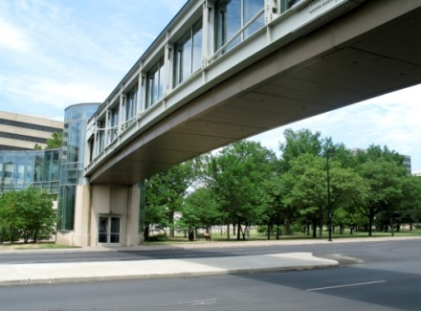
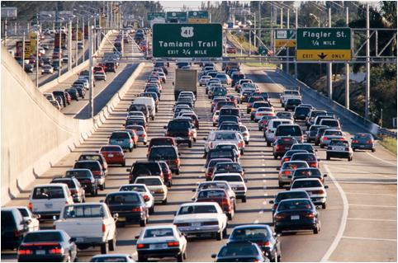
WELCOME!!!!
FDOT District Seven
Local Agency Program (LAP)
Compliance Workshop
May 16, 2017
CCCA Field Office Review:
Section I: Process and File Organization
A1

Slide 2
On Line Resources
FHWA 1273 05/12
http://www.fhwa.dot.gov/programadmin/contracts/1273/1273.pdf
Contract Compliance Manual
http://www.fdot.gov/equalopportunity/ContractComplianceWorkbook.shtm
LAP Manual
http://www.fdot.gov/programmanagement/LAP/LAP_TOC.shtm
USDOL (Wage Determinations online)
https://www.wdol.gov/
DBE Regulations CFR 49 Parts 23 and 26
http://www.fdot.gov/equalopportunity/dbeprogramfaq.shtm
DBE Directory (EOC)
http://www3b.dot.state.fl.us/EqualOpportunityOfficeBusinessDirectory/CustomSearch.aspx
Equal Opportunity Officer (Directory)
http://www.fdot.gov/equalopportunity/Contract%20Compliance/EOO%20officer%202%205%2015.pdf
FDOT Forms Library (NEW!!!!)
http://www.fdot.gov/equalopportunity/ContractCompliance.shtm
CCCA Field Office Review:
Section I: A2, A3, A7

Slide 3
Section 2.01 of the LAP Agreement
2.01 General Requirements:
The project will be performed in accordance with all applicable Department procedures, guidelines, manuals, standards, and directives as described in the Department's Local Agency Program Manual, which by this reference is made a part hereof as if fully set forth herein . . .
Meaning…..Pre-Con Agenda, The Compliance Manual and DCE memorandums

Slide 4
What does that mean?
AA= Affirmative Action
CCM= Contract Compliance Manual
CFR= Code of Federal Regulations
CUF= Commercially Useful Function
DCE= District Construction Engineer
DBE= Disadvantaged Business Enterprise
DCCM= District Contract Compliance Manager
DCCO= District Contract Compliance Office
EEO= Equal Employment Opportunity
EOC= Equal Opportunity Compliance
EOO= Equal Opportunity Office
FAP= Federal Aid Participation
FHWA= Federal Highway Administration
FIN= Financial Identification Number
LA= Local Agency
LAP= Local Agency Program
NAICS= North American Industry Classification Sys
NNC= Notice of Noncompliance
OJT= On the Job Training
RCS= Resident Compliance Specialist
SCO= State Construction Office
PRV= Payroll Violation
PWR= Prevailing Wage Rate
USDOL= United States Department of Labor

Slide 5
FHWA 1273- FDOT Compliance Implementation
To take advantage of FHWA funding, the State of Florida must develop and enforce a construction contract compliance program in accordance with FHWA 1273
Florida’s program is outlined in:
FDOT Topic 275-020-005
Construction Contract Compliance Manual

Slide 6
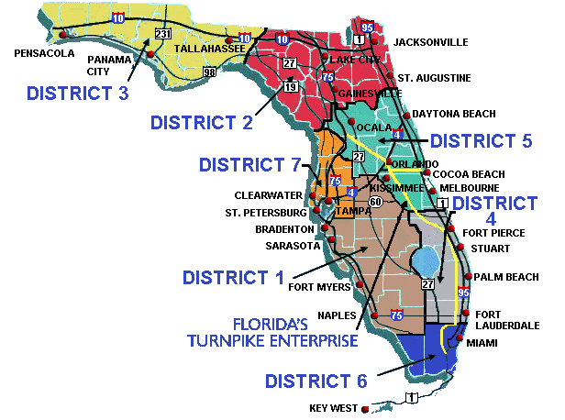
FHWA 1273 – Requirements for the State of Florida
Noncompliance could result in FHWA removing federal funds from:
The Project
The entire District
The entire State of Florida!!!

Slide 7
FDOT Construction Contract Compliance Manual
FDOT Construction Contract Compliance Manual (CCM)
effective as of August 17, 2016
Topic 275-020-005
FDOT’s approved program for contractor compliance reporting and monitoring to achieve a consistent predictable and repeatable (CPR) compliance program
It provides a detailed explanation of the general compliance requirements forms, record keeping and analytical tools for reporting and monitoring compliance on construction and design build contracts

Slide 8
FDOT Construction Contract Compliance Manual
This manual reflects the compliance monitoring program approved by the Federal Highway Administration (FHWA) for FDOT. Any deviation from the policy outlined in the CCM including additional requirements, requires prior approval from the State Construction Office (SCO) and the Equal Opportunity Office (EOO). The requests must include a compelling justification by the District Construction Engineer (DCE).

Slide 9
General Information

Slide 10
Nondiscrimination Assurance
C.C.M.
1.1.2.1
Nondiscrimination Assurance Required in each Contract and Subcontract (49 CFR 26.13):
“The contractor, sub recipient, subcontractor or rental agreement shall not discriminate on the basis of race, color, national origin, or sex in the performance of contracts.
The contractor shall carry out applicable requirements of 49 CFR Part 26 in the award and administration of DOT-assisted contracts.
Failure by the contractor to carry out these requirements is a material breach of their contract which may result in the termination of that contract or such remedy as FDOT deems appropriate.”

Slide 11
Prime Contractor Responsibilities
C.C.M.
1.1.7
The Prime Contractor is responsible for compliance by any subcontractor or lower tier subcontractor
All contractors are to implement and maintain, throughout the course of a contract, actions which comply with their contractual obligations. Records evidencing each aspect of required compliance are to be developed and maintained by all contractors for a minimum period of three years following the date of final payment of the contract for all work regardless if such records are or are not routinely collected by the FDOT during the contract

Slide 12
Prime Contractor Compliance Process
C.C.M.
1.1.8
The prime is responsible for the compliance on the project. Implementation of the primes compliance responsibility requires development of a process for reviewing and confirming their contractors compliance with all aspects of EEO, DBE, OJT and Wages
A prime’s process may entail any one of a multitude of approaches including but not limited to:
Requiring documentation submissions
Verification of data
Relying solely on a subcontractors affirmation of compliance may not be adequate

Slide 13
Default of the Prime Contactor
C.C.M.
1.1.10
In the event a prime contractor defaults on a contract and their contractor compliance data is incomplete or incorrect, the Resident Compliance Specialist (RCS) will proceed with all noncompliance communications and actions such that the surety company and/or the successor contractor are fully aware of the conditions. A surety company is exempt from contract compliance reporting requirements but is responsible to ensure that the successor contractor carries out the requirements

Slide 14
District Construction Office
C.C.M.
1.2.3
Under each District Construction Compliance Office (DCCO), a District Contract Compliance Manager (DCCM) is responsible for the day-to-day administration of the contract compliance program. The RCS’s monitor contract compliance at the project level
The DCCO will conduct a Construction Contract Compliance Administration (CCCA) Review of the RCS’s projects to determine if the EEO procedures are being followed. Project records (files) will be reviewed for accuracy and content to ensure contract compliance with EEO, OJT, and DBE contract clauses and contract activities
Handout #1

Slide 15
Construction Contract Compliance Administration Review
A written report will be prepared and review findings and recommendations will be forwarded to the sub recipient
Any deficiencies noted in the report should be corrected with in (14) days of the formal report
Construction Contract Compliance Administration (CCCA) Review; (FDOT Form No. 275-021-32)
LAP Manual Section 15.3.3, page 7, Paragraph 2 & 3 states; Review should be conducted as early in the active portion of the project no later than 30% construction completion, then it goes on to say FDOT staff may review projects at 60%, 90% and final completion of the project, but will conduct review no less than twice at 30% and final completion of the project. The number of reviews will be determined by the DCCM
Per LAP Manual Section 15.5 the final CCCA Review will allow the processing for final reimbursement. Project must be in compliance to receive final payment
Handout #2

Slide 16
Resident Compliance Specialist
C.C.M.
1.2.4
The Resident Compliance Specialist (RCS) will:
Provide technical assistance to contractors and subcontractors
Ensure contractors are entering DBE commitments and payments through EOC; submit/reject DBE commitments and payments through EOC; monitor the project of the contract and DBE participation
Maintain the official compliance records for the project
Assist the DCCO in compliance review activities
Determine if DBE’s are performing CUF
Maintain all documents, conduct interviews, and monitor contractors compliance related to the OJT program
Notify the DCCO of specific concerns or issues regarding contractors compliance with FHWA 1273 and other federal authorities

Slide 17
Equal Opportunity Compliance System (EOC)
C.C.M.
1.3
The EOC System currently supports the FDOT’s Disadvantaged Business Enterprise (DBE) data collection and reporting requirement:
Submit bidder opportunity within (3) days of submission of bids
EOC closes bidder opportunity (30) days after bid opening
Prime Contractor enters DBE Commitments
Prime Contractor enters DBE’s monthly payment data in EOC System
Local Agency RCS needs to obtain access to monitor the entries made by the Prime Contractor
CCCA Field Office Review:
Section III (H): DBE

Slide 18
Contractor Compliance Register
C.C.M.
1.5
The Equal Opportunity Reporting System stores the basic identification and EEO compliance information of contractors
Notification to FDOT of EEO Officer
Contractor data stored in the register is to match data on jobsite bulletin board prior to begin date
CCCA Field Office Review:
Section II (C1): EEO

Slide 19
Performance Deficiency Communications and Actions
C.C.M.
1.6
Noncompliance non·com·pli·ance / noun
failure or refusal to comply, as with a law, regulation, or term of a contract

Slide 20
Issues of Deficiency Communications
C.C.M.
1.6.2
Deficiency communications shall be issued to the Prime for the Prime and/or subcontractor’s noncompliance with compliance program requirements including the submission of required data in any element of the program:
EEO, DBE, Wages, OJT
CCCA Field Office Review:
Section II: EEO
Section III: DBE
Section IV: OJT
Section V: Wages

Slide 21
Noncompliance Sanctions
C.C.M.
1.6.3
Two (2) sanctions are concurrently applied when a performance deficiency exists:
Withholding of Monthly Progress Estimate(s)
Issuance of Performance Deficiency Letter(s)
A projects monthly progress estimate(s) is withheld in it’s entirety for a performance deficiency. Upon the Local Agency's receipt and verification of compliance with outstanding requirements, the withheld monthly progress estimate(s) is released for payment processing

Slide 22
Noncompliance Communications
C.C.M.
1.6.5
ALL communications regarding performance deficiency are addressed to the prime contractor for resolution
If the prime is not very experienced, they may ask the RCS (or Local Agency) to help them communicate with the subs. This would only be if the prime authorized the direct communication and the prime should be involved in all such communications/meetings
LOCAL AGENCY → PRIME CONTRACTOR
CCCA Field Office Review:
Section V: Wages
N5

Slide 23
Noncompliance Communications
C.C.M.
1.6.5
Communication Vehicles:
Noncompliance Letters
1. Notice of Noncompliance Letter (7 business days to resolve)
2. Performance Deficiency Warning Letter including Notice of Intent to Withhold Monthly Progress Estimate (7 business days to resolve)
3. Performance Deficiency and Withholding Letter (Estimate withheld until resolved)
Notification of Payroll Violation (Form # 700-010-59) (20 calendar days to resolve)
Chapter 1: CCM Reference Guide provides examples of citing for noncompliance communications

Slide 24
Summary of Communications
C.C.M.
1.6.5.1
This tables summarizes the (4) levels of progressive written communications that are available

Slide 25
Communication to D7
D7 LAP Compliance DCCM (Mary Blasewitz) should be included on ALL Noncompliance Communications (Notices and Payroll Violations) to the Contractor!
Local Agency → Contractor (Notices)
Local Agency → DCCM→ CARS: Payroll Violation System (Payroll Violations)

Slide 26
Sub recipient Monitoring (Local Agency)
C.C.M.
1.7.3
FDOT
Local Agency
Prime Contractor
Sub-Contractor
FHWA
Who monitors who?

Slide 27
Subcontracts/Purchase Orders
C.C.M.
1.7.4
The prime contractor is responsible for assuring that all subcontractors are in compliance with the required Equal Employment Opportunity Special Provisions of the contract.
Prime contractors may accomplish work of a project by entering into subcontract arrangements with written agreements (“Subcontracts”) containing the requirements and pertinent provisions of the prime’s contract. Subcontractors may further subordinate their contract and such relationships are known as second tier, third tier, etc. subcontracts.
CCCA Field Office Review:
Section II: EEO
E2

Slide 28
Subcontracts/Purchase Orders
Written agreement must include by BOTH REFERENCE and ATTACHMENT (in its entirety):
FHWA 1273 (5/12)
Contract Wage Decision
CCCA Field Office Review:
Section II: EEO
E2

Slide 29
Subcontracts/Purchase Orders
LAP Manual Section 15.2 requires a Local Agency to include the “Required Contract Provisions for Federal-Aid Construction Contracts” (also known as FHWA 1273) into all construction contracts. The Wage Rate Decision must be attached to all contracts and subcontracts per FHWA 1273
Special Provision Sub-article 7-1.1 which invokes FHWA 1273, May 1, 2012 -- included in its ENTIRETY and Sub-article 7-16, Wage Rates for Federal Aid Projects
Purchase Orders, Rental Agreements, and TEA forms need only have the provisions referenced
CCCA Field Office Review:
Section II: EEO
E2

Slide 30
Subcontracts/Purchase Orders
Per LAP Manual, DCE Memo 10-12 and Construction Contract Compliance Administrative (CCCA) Review
Each district will incorporate a process to verify subcontracts include Form-1273 for all federal aid jobs
This verification process will include no less than 20% of all subcontracts and purchase orders
CCCA Field Office Review:
Section II: EEO
E2

Slide 31
Who are My Subcontractors?
C.C.M.
1.7.4
Local Agency MUST BE MADE AWARE OF ALL subcontractors PRIOR to them starting work on the project (all tiers)
1. Certification of Sublet Work
2. Notice of Rental Agreement
3. Temporary Employment Agencies
CCCA Field Office Review:
Section II: EEO
E2

Slide 32
Certification of Sublet Work
C.C.M.
1.7.4
Certification of Sublet Work (FDOT Form No. 700-010-36)
Use of the Certificate of Sublet is recommended for Local Agency Projects but not required. However, the certified information on the sublet form shall be obtained by the Local Agency for their Federal-Aid Project:
Contracted Firm
Who has an agreement with the Contracted Firm
Type of Work Contracted
Dollar Amount Contracted
CCCA Field Office Review:
Section II: EEO
E1

Slide 33
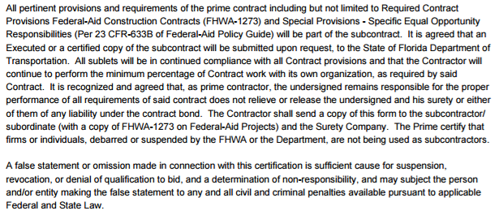
Certification of Sublet Work
C.C.M.
1.7.4
Verbiage in bottom left hand corner of form is “BINDING” requires inclusion of Federal Provisions in their ENTIRETY (not just by reference) in subcontractor agreements
CCCA Field Office Review:
Section II: EEO
E1

Slide 34
Notice of Rental Agreement
C.C.M.
1.7.4
Notice of Rental Agreement (FDOT Form No. 700-010-11)
May require EEO and/or Payroll Monitoring based on: - Rental is WITH or WITHOUT operator
- Rental is Over/Under $10,000
Exception - NOT REQUIRED if rental is without an operator and from an equipment dealer or firm whose principle business is equipment rental (ex. Neff Rental)
CCCA Field Office Review:
Section II: EEO
E4

Slide 35
Temporary Employment Agency
C.C.M.
1.7.5
Notification to FDOT for Use of Temporary Employment Agency (TEA) / Day
Laborers (FDOT Form No. 275-021-15)
Due BEFORE any TEA workers report to project site
Submitted/Signed by HIRING Contractor
Signed by PRIME Contractor
TEA’s submit their OWN certified weekly payrolls
Contractor and TEA are joint employers
TEA workers are not excluded from the federal provisions or DBRA....meaning payrolls are required
CCCA Field Office Review:
Section II: EEO
E3

Slide 36
Summary of Subcontracts and Rental Agreements

Slide 37
Local Agency Program
C.C.M.
1.7.7
FDOT’s LAP Projects are Federally funded and therefore are, required to conform to FHWA 1273, required contract provision of federal aid construction contracts
Meaning…….
Contractors of LAP projects may demonstrate compliance with FHWA 1273 and Davis-Bacon and Copeland Acts by adhering to either the forms and reporting requirements of the specific local agency or by conforming to the forms and requirements of the FDOT EEO Construction Contract Compliance Manual. The Local Agency informs contractors of the requirements to be followed at the Pre-Construction Conference.

Slide 38
Davis Bacon Act
C.C.M.
1.7.7
LAP projects are Federally Funded and are subject to Prevailing Wage Requirements:
Government Contracts Acts:
Davis Bacon Act (DBA)
Copeland Act (Anti-kickback Act)
Contract Work Hours and Safety Standards Act (CWHSSA)
Title VI of the Civil Rights Act of 1964
Fair Labor Standards Act (FLSA)
Regulate
Payment of Wages
Record keeping and reporting
Overtime pay

Slide 39
Disadvantaged Business Enterprise

Slide 40
LAP Manual
Section 14.1.2 –
Contracts issued by Local Agencies that have FHWA funds must be in compliance with the FDOT DBE Program!
CCCA Field Office Review:
Section III: DBE

Slide 41
49 CFR Part 26
USDOT requires all recipients of FAA, FTA and FHWA federal funds to participate in a Unified Certification Program (UCP) within their respective states that maintains goals and assistance for participation in the DBE program
Local Agencies are recipients of FHWA funds

Slide 42
FDOT DBE Program and Goal
C.C.M.
2.1
Assists small businesses owned and controlled by socially and economically disadvantaged individuals participate on Department contracts
Race-Neutral DBE Program –
Goal can be achieved through the normal competitive procurement process
Individual Goals not assigned to contract
9.91%
Until 10/1/2017

Slide 43
Certification of DBE’s
C.C.M.
2.2
Unified Certification Program (UCP) – One-stop shopping for DBE’s
Specialty Codes - Each DBE certification includes specific NAICS and FDOT Specialty Codes indicating the work in which they are certified
Reporting - The Department can only report participation of DBE’s that are certified in the Department’s DBE Directory
CCCA Field Office Review:
Section III: DBE
H1

Slide 44
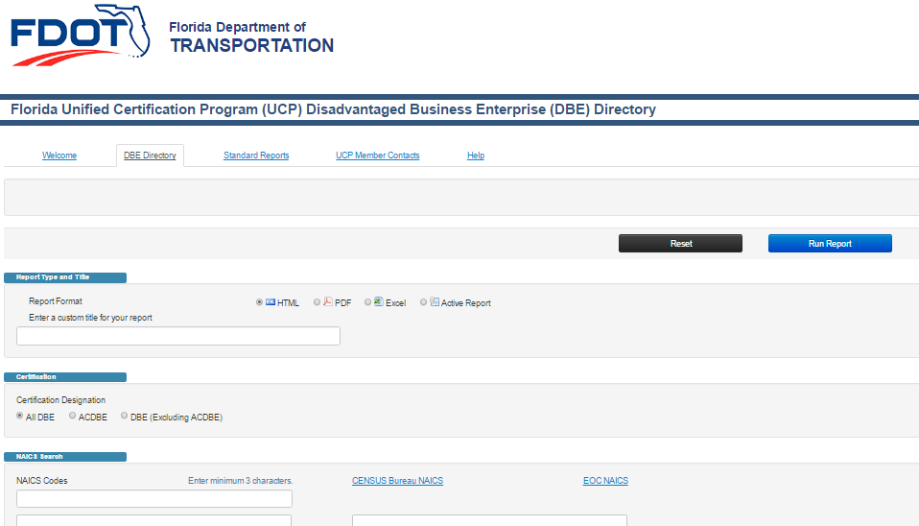
DBE Directory
C.C.M.
2.2.2
How do I know if a Subcontractor is a Certified DBE?
CCCA Field Office Review:
Section III: DBE
H1

Slide 45
DBE Directory
C.C.M.
2.2

Slide 46
DBE Directory

Slide 47
Bid Opportunity Reporting
C.C.M.
2.4
ALL Contractors- MUST enter their bid opportunity information in the Equal Opportunity Compliance (EOC) system within three (3) business days of submission of the bid or proposal
EOC closes the Bid Opportunity Reporting in EOC 30 days after Bid Opening
All unregistered primes submitting a bid will need to apply for an EOC user ID and password to gain access to the EOC system
CCCA Field Office Review:
Section III: DBE
H1

Slide 48
DBE Participation Commitments
C.C.M.
2.5
DBE Participation Commitments:
Initial Submission and Revisions
Prime Contractor (only) submits
DUE by Pre-Construction meeting
ONLY report commitments for companies certified as a DBE
Update EOC Commitments when:
(1) DBEs are added (+) or removed (-)
(2) Dollars to DBE Subcontractors change
DBE’s can be Contractors, Material Suppliers, Manufacturers, and Professional Service Providers
CCCA Field Office Review:
Section III: DBE
H1

Slide 49
Counting a DBE’s Participation
C.C.M.
2.5.3

Slide 50
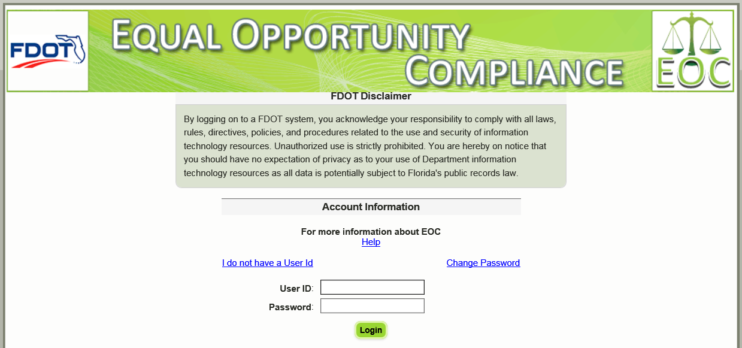
Reporting Actual Payments
C.C.M.
2.6
49 CFR Part 26 - Department MUST also track ACTUAL payments made to DBE’s!!!
Reporting:
PRIME enters payments in EOC MONTHLY including zero dollar payment*:
CCCA Field Office Review:
Section III: DBE
H2
*LAP Manual 14.5.3

Slide 51
Reporting Actual Payments
C.C.M.
2.6
CCCA Field Office Review:
Section III: DBE
H2

Slide 52
Reporting Actual Payments
C.C.M.
2.6
To approve or reject DBE payments in EOC System have in hand:
Local Agency User ID/Password
Subcontractor list / Certificate of Sublet
DBE Profile from DBE Directory
DBE Trucking (Prime approved) Certification

Slide 53
Commercially Useful Function (CUF)
C.C.M.
2.7
Commercially Useful Function (CUF) DBE Monitoring Report (FDOT Form No. 275-021-18)
Complete a CUF for whom?
ALL Active DBE’s, except:
Professional Service firms (i.e. QC Testing)
DBE Trucking Companies
DBE Material Suppliers
Perform a CUF how often?
Each Month for the 1st three months a DBE is active on the project
CCCA Field Office Review:
Section III: DBE
I1-I6

Slide 54
Commercially Useful Function (CUF)
C.C.M.
2.7
RCS
completes
& submits
to field
Field
Inspector
completes & submits to RCS

Slide 55
Commercially Useful Function (CUF)
C.C.M.
2.7

Slide 56
30% - Performance of Work
C.C.M.
2.7
A DBE must perform at least 30% of the work to be counted for DBE participation
Exception - 30% work requirement DOES NOT apply to DBE Trucking Services
CCCA Field Office Review:
Section III: DBE
I2

Slide 57
Final CUF Assessments
C.C.M.
2.7

Slide 58
Counting DBE Trucking Companies
C.C.M.
2.7
DBE must be responsible for management of entire trucking operation
DBE must own and operate at least one truck on the project
If a DBE leases trucks from another DBE firm, including an owner-operator who is certified as a DBE, the DBE who leases trucks from another DBE receives credit for the total value of the transportation services the lessee DBE provides on the contract
DBE credit is given for OBE trucks only up to the value of services provided by all DBE trucks
Utilization credit is given ONLY for the fee or commission associated with excess services provided by OBE trucking
CCCA Field Office Review:
Section II: EEO
F2

Slide 59
DBE Trucking Recordkeeping
C.C.M.
2.7
Contractual Documents – Off Site DBE Hauling
Sublet, Subcontract, Rental Agreement – including scope of trucking operations, commissions/fee rate
2. Trucker’s Observation & Verification (FDOT Form No. 700-010-610)
Performed to verify the owner operator and DBE status of individual trucks
3. DBE Trucking Certification (FDOT Form No. 275-030-14)
Prime Contractors submit EACH month
Due beginning with 1st month
Ending with last month
Inactive months reported as such
CCCA Field Office Review:
Section II: EEO
F2

Slide 60
DBE Trucking Certification
LAP Manual 2.7.7.1 - FDOT requires prime contractors reporting commitments for DBE trucking to submit each month a DBE Trucking Certification (FDOT Form 275-030-14) reflecting actual trucking operations. The report is due beginning with the first month of the contract and ending with the last month of the contract; inactive months will be reported as such

Slide 61
DBE Manufactures and Suppliers
C.C.M.
2.7
DBE Manufacturer → Count 100%
DBE Regular Dealer → Count 60%
DBE not a Manufacturer or Regular Dealer → Count 100% of Commissions/Fees
Definition of Regular Dealer → Established, regular business that engages as its principal business in the purchase and sale or lease of products.
NOTE: Packagers, brokers, manufacturer’s representatives or other persons who arrange or expedite transactions are not regular dealers.

Slide 62
Commercially Useful Function (CUF)
C.C.M.
2.7
Records for Verification of Performing CUF may be requested:
Contracts, Subcontracts, Rental Agreements
Invoices in lieu of CUF forms:
Material Suppliers
Professional Services
DBE Trucking Certification
Material/Supply Agreements
Payroll Records
CCCA Field Office Review:
Section III: DBE
I1-I6

Slide 63
10:15 – 10:30

Slide 64
Company EEO

Slide 65
Equal Employment Opportunity
C.C.M.
3
Applicable to all Federal Aid Construction Contracts of $10,000 or more (for both prime contractor and subcontractors)
$10,000

Slide 66
Company EEO
C.C.M.
3.2-3.7
EEO/AA Plan
EEO Officer
Supervisory and Personnel EEO Meetings
Company-Wide EEO Reports (OJT Projects)
Contractor Recruitment Program
Non Segregated Facilities
Analysis for Nondiscrimination
NOTE: Required to be on file by Contractor and can be requested at any time by FDOT

Slide 67
Project EEO

Slide 68
Project EEO
C.C.M.
4
Jobsite Bulletin Board
EEO Officer (Check FDOT EEO Officer Directory)
EEO Project Personnel Meetings
Annual July EEO Report
Training Assessments (NEW!!)
ALL Monitored by Local Agency –RCS!!!
CCCA Field Office Review:
Section II: EEO

Slide 69
Job Site Bulletin Board
C.C.M.
4.2
Inspection Report for Job Site Bulletin Board (FDOT Form No. 275-021-10)
PRIME Contractors (only) are responsible to maintain
Install and maintain a fixture displaying information on various rights, protections, and appeals
Physically located where it is accessible to all workers and the public 24/7
Install before work begins
CCCA Field Office Review:
Section II: EEO
G1-G4

Slide 70
Job Site Bulletin Board
C.C.M.
4.2
What should be on the Board?
(5) FDOT required posters
(3) USDOL required posters
Wage Decision (ALL pages clearly displayed)
Additional Wage Classifications
EEO Officers (Prime and ALL subs over $10,000)
CCCA Field Office Review:
Section II: EEO
G1-G4

Slide 71
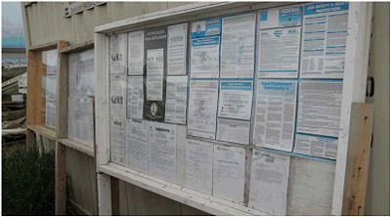
Job Site Bulletin Board
C.C.M.
4.2
Be Sure………………..
Documents are maintained to withstand weather
DO NOT remove board until final acceptance!!
CCCA Field Office Review:
Section II: EEO
G1-G4

Slide 72
Job Site Bulletin Board
C.C.M.
4.2
When do I inspect the Board?
At the START of the project
Subsequent QUARTERLY inspections (at a minimum)
Re-inspect for CORRECTING NONCOMPLIANCE
Re-Inspect if:
ADDING SUBCONTRACTOR (for posting of EEO Officer information)
ADDITIONAL WAGE CLASSIFICATION APPROVAL
TAKE PICTURES!!!!!
CCCA Field Office Review:
Section II: EEO
G1-G4

Slide 73
Annual July Report
C.C.M.
4.4
Contractor’s Annual July EEO Report
One (1) report from FDOT :
→ FHWA
→ U.S. Senate
Total employment on all Federal Aid highway projects
Why July? - Good weather month nationwide
Memo sent to Prime for 8/20 submittal
Compiled for submittal to D7 DCCM by 9/1
CCCA Field Office Review:
Section II: EEO
D1

Slide 74
Training Assessments
C.C.M.
4.5
Purpose:
To assess the level of experience and comprehension of a Contractor’s EEO compliance staff with the requirements of FHWA 1273 for federal aid contracts. The training assessment is to identify areas where the EEO Officer of Contractor may need additional training and may be used as one factor in determining the schedule for official Contract Compliance Reviews as described in Section 4.6.
Handout #3

Slide 75
Training Assessments
C.C.M.
4.5
EEO Checklist:
Part A can be found in Chapter 4 of the CCM Reference Guide and will be completed during the training assessment meeting
Part B will be completed during an on-site review of the job site. The on-site review will include an inspection of the Jobsite Bulletin Board and 5 employee interviews (if available)
Database for checklist:
When the checklist has been completed, the RCS will enter the results of the checklist (the rating percentage) in the Contract Compliance database along with other required information, such as the company being addressed, the date, person conducting the assessment, etc. within five (5) working days of completing the assessment

Slide 76
Project Contractor Compliance Reviews
C.C.M.
4.6
Purpose:
The Federal Highway Administration (FHWA) requires the Florida Department of Transportation (FDOT) as a contracting agency to assure compliance of contractors with the requirements of federal-aid construction agency to assure compliance of contractors with the requirements of federal-aid construction contracts including the Equal Employment Opportunity (EEO), Disadvantaged Business Enterprise (DBE), and On-the-Job Training (OJT) requirements
For a project review, the DCCO shall hold the prime contractor responsible for ensuring that all active subcontractors are present at the on-site meeting and have supplied the required documentation.

Slide 77
On-the-Job Training

Slide 78
On-the-Job Training
C.C.M.
5
When is it required?
Construction dollar amount is equal to or above 2 million
AND
Contract time is 275 calendar days or more
CCCA Field Office Review:
Section IV: OJT

Slide 79
On-the-Job Training
C.C.M.
5
OJT Required Actions / Forms:
Training Evaluation Meeting
OJT Schedule
Trainee Enrollment
Proficiencies
Trainee Interview
Monthly Time Reports (MTR)
CCCA Field Office Review:
Section IV: OJT

Slide 80
On-the-Job Training
C.C.M.
5
D7 DCCM will assist during the preparation of the OJT Evaluation Meeting
CCCA Field Office Review:
Section IV: OJT

Slide 81
11:30 – 1:00

Slide 82
Wages

Slide 83
Wage Decision
C.C.M.
6.2
CORRECT WAGE TABLE
CCCA Field Office Review:
Section V: Wages
K1
Wage table is valid for the life of the contract

Slide 84
Wage Decision
C.C.M.
6.2.1
1) A listing of wage rates and fringe benefit rates
2) By classification of laborers and mechanics
3) For a given area (county)
Link to USDOL Wage Decisions:
http://www.wdol.gov/dba.aspx#0
Link to Summary of Wage Determinations by County:
http://www.dot.state.fl.us/construction/wagerate/2012_USDOL_Wage_Tables.pdf
CCCA Field Office Review:
Section V: Wages
K1

Slide 85
Wage Decision
C.C.M.
6.2.2
Four (4) types of construction:
(1) Building
(2) Heavy
(3) Highway
(4) Residential
May have more than one applicable wage decision
Link to Guidelines for Multiple Wage Tables on Contracts:
CCCA Field Office Review:
Section V: Wages
K1
http://www.dot.state.fl.us/construction/wagerate/GuidelinesForUsingMultipleWageRates.pdf

Slide 86
USDOL Rules

Slide 87
Wage Decision
C.C.M.
6.2.4
May contain two separate requirements for any individual classification:
“Rate” and “Fringes” = Total Requirement
Contractor may fulfill total wage requirement for a classification by paying Cash and Bona Fide Fringe Benefits in a variety of combinations
CCCA Field Office Review:
Section V: Wages
K1

Slide 88
Additional Wage Classifications
C.C.M.
6.3
Additional Wage Classification System
Prime must submit request in the Classification Request Manager
User ID and password is needed
https://fdotewp1.dot.state.fl.us/WageRateExternal/Login/Index?ReturnUrl=/WageRateExternal/
Contractor submits request thru Classification Request Manager
FDOT validates and sends request to USDOL
USDOL reviews request and either concurs or proposes acceptable rate
CCCA Field Office Review:
Section V: Wages
K2

Slide 89
Additional Wage Classifications
C.C.M.
6.3.3
Contractor can include additional classifications on certified payroll and pay at least the minimum amount until response received
Once received from USDOL, contractor must retroactively make any pay adjustments required if rates approved are greater than rates paid in interim period
Once approved - Must be posted on jobsite bulletin board
Can use FDOT Form No 700-010-67 or just post the approval letter from USDOL
CCCA Field Office Review:
Section V: Wages
K2

Slide 90
Additional Wage Classification
C.C.M.
6.3.3
Once the wage decision has been received from the US Department of Labor, the contractor must retroactively make any pay adjustments required, if the rates approved are greater than the rates paid to employees, in that classification. In the event the response indicates that the work is included, in that of an existing classification, the contractor is to begin immediately using the indicated classification and must retroactively pay any difference in rate resulting from this decision
The contractor will be given 20 days from the date of notification from FDOT to make retroactive pay adjustments, if needed. The 20 days also applies to submission of corrected payrolls and documents evidencing payment to the affected employees. If these adjustments are not made within this timeframe, payroll violations will be issued

Slide 91
Labor Interviews
C.C.M.
6.4
Employee Interview Report – Labor Compliance (FDOT Form No. 700-010-63)
Used to monitor payments made on Federal Aid construction projects in accordance with FHWA 1273
Provides for monitoring of:
Proper Classification
Wage Payment
Knowledge of EEO Officer and Bulletin Board
CCCA Field Office Review:
Section V: Wages
O1-O2
Handout #4

Slide 92
Labor Interviews
C.C.M.
6.4.3
Required Minimum # of Monthly Interviews
Table 6.4.3 - Based on the original contract amount
Conducted on a random basis
Cross section of active contractors and diversity of workers
All workers are subject to an interview
With the exception of Surveyors, Supervisors, QA/QC Testing, etc.
CCCA Field Office Review:
Section V: Wages
O1

Slide 93
Labor Interviews
C.C.M.
6.4
Performed for who?
Both prime and subcontractors
Performed by who?
Any project personnel or the compliance delegate
Compliance reviewer’s responsibility?
Ensure appropriate number of interviews was conducted
Review interview data for compliance (complete Section D)
CCCA Field Office Review:
Section V: Wages
O1-O2

Slide 94
Labor Interviews
C.C.M.
6.4
Considerations when performing interviews:
Language barriers
Interviews are CONFIDENTIAL
No other employees or supervisors within listening distance
Don’t send interviews to Contractor when you have a discrepancy – they are confidential!
CCCA Field Office Review:
Section V: Wages
O1-O2

Slide 95
Labor Interviews
C.C.M.
6.4
SECTION D Must be reviewed against actual field observation and ensure the payroll reports
Highest classification of work
Sufficient wages for work performed interview discrepancies REQUIRE follow up and documentation of your actions
CCCA Field Office Review:
Section V: Wages
O1-O2

Slide 96
Payrolls
C.C.M.
6.5.2
Contractor’s are REQUIRED to PAY no less than weekly (every 7 days) and report these payments weekly via submission of the Certified Weekly Payrolls
CCCA Field Office Review:
Section V: Wages
L13

Slide 97
No Work Payrolls
C.C.M.
6.5.2
“No Work” Payrolls - Not required but need to confirm by some method that contractor is not active on project (i.e., inspector field dailies or email correspondence)

Slide 98
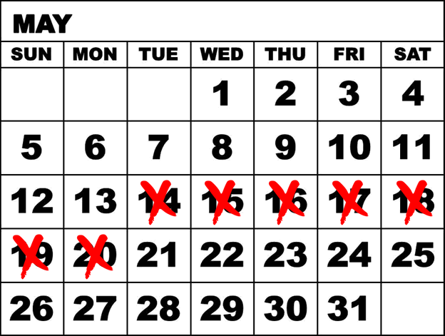
Submittal of Payrolls
C.C.M.
6.5.2
Weekly Certified Payroll is Due to Compliance Delegate
7 Calendar Days after Contractor’s Regular Payment Date
CCCA Field Office Review:
Section V: Wages
L1

Slide 99
Submittal of Payrolls
C.C.M.
6.5.2
Obtain the pay period and pay date of each contractor for tracking of submittal due date
Use a Payroll Tracking Sheet to monitor due dates
Obtain payrolls from ALL Contractors and Subcontractors active on construction project
Payrolls due for every week in which any contract work is performed
CCCA Field Office Review:
Section V: Wages
L1-L13

Slide 100
Submittal of Payrolls
C.C.M.
6.5.2
Excluded on project certified payrolls are employees such as:
architects
engineers
timekeepers
administrative staff
surveyors
quality assurance staff
inspectors

Slide 101
Deductions
C.C.M.
6.5.3
Purpose: To ensure there is no violation of the Copeland “Anti-Kickback” Act
Deductions must be presented:
in detail
by type
by amount
ARE THEY ALLOWABLE?
CCCA Field Office Review:
Section V: Wages
M1-M3

Slide 102
Deductions
C.C.M.
6.5.3
Permissible Deductions without USDOL Approval (Examples)
Taxes (Federal WH, FICA, State Income Tax)
Court Orders (Garnishments, Child Support)
Insurance (Health, Life)
Automatic Payroll Deposits (Financial Institutions, Charities)
Pension Funds
Employee Loans/Advances
CCCA Field Office Review:
Section V: Wages
M1-M3

Slide 103
Deductions
C.C.M.
6.5.3
Supporting Documentation Needed for Certain Permissible Deductions
Court Orders (Garnishments)
• Administrative Fee being charged - Obtain copy of court order as needed to determine the amount allowed (or not) by the court order
Employee Loans/Advances
• Signed employee approval including deduction amount
• Cannot charge interest on an employee loan
CCCA Field Office Review:
Section V: Wages
M1-M3

Slide 104
Deductions
C.C.M.
6.5.3
Supporting documentation for any deduction may be requested at any time by the Local Agency or FDOT
CCCA Field Office Review:
Section V: Wages
M2

Slide 105
Deductions
C.C.M.
6.5.3
Other deductions are allowable that meet the following requirements:
Contractor does not profit directly or indirectly
Not prohibited by law
Voluntary - consented to by the employee and is not a condition of employment
Serves the convenience and best interest of the employee
CCCA Field Office Review:
Section V: Wages
M1-M3

Slide 106
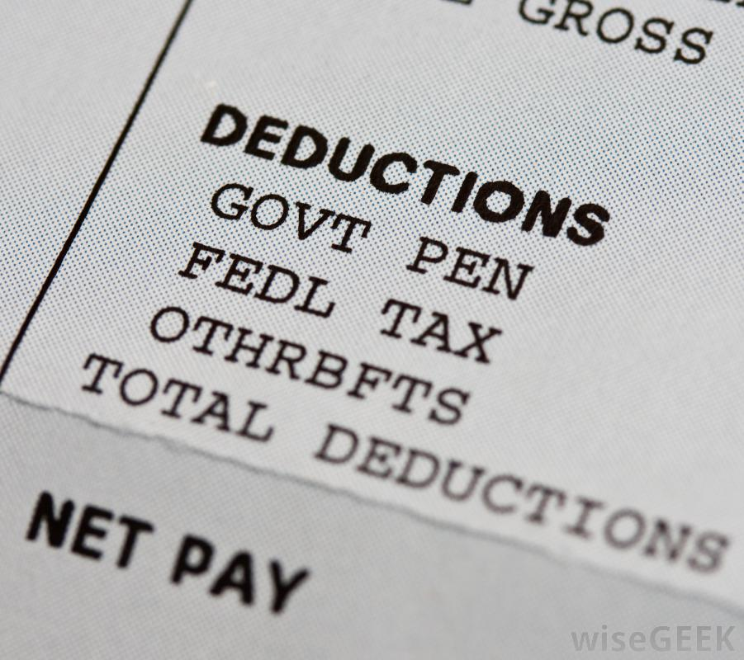
Deductions
C.C.M.
6.5.3
USDOL approval required for:
• Uniform rentals/cleaning
• Cell phone
• Use of company vehicle
Obtain copy of USDOL approval letter
Must be applicable to:
(1) Project period
(2) Specified deduction
CCCA Field Office Review:
Section V: Wages
M1-M3

Slide 107
Deductions
C.C.M.
6.5.3
Specific authorization must be obtained prior to taking deduction
Retroactive approval (to a specific date) may be requested and may be considered for approval by USDOL
Contractor submits signed request on company letterhead
CCCA Field Office Review:
Section V: Wages
M1-M3

Slide 108
Overtime
C.C.M.
6.5.5
Overtime → Hours worked in a workweek over 40 hours
WD Rate of Pay x 1.5
Overtime payments are based on TIME ACTUALLY WORKED and cannot include holiday, vacation or other time paid but not worked.

Slide 109
Wage Classifications
C.C.M.
6.5.6
Permissible Wage Classifications
Payroll record must reflect the employee’s classification of work as listed on the Wage Decision (WD) or on the list of Additional Wage Classifications
Examples that ARE NOT VALID CLASSIFICATIONS:
Semi-Skilled
Laborer
Operator

Slide 110
Work in More than One Classification
Payrolls containing multiple classifications separated by “/” for one prevailing cash rate are not to be accepted. The contractor shall revise the payroll to reflect the employee working in the highest classification or track time spent working per classification as described in CCM 6.5.7
Example: Employee classification would be listed as “Operator: Crane/General Laborer/Pipelayer”; per the wage decision the Operator: Crane classification has the highest wage rate. RCS shall have contractor revise payroll to list highest classification of Operator: Crane

Slide 111
Work in More than One Classification
C.C.M.
6.5.7
When an employee’s work on a project includes more than one classification during a payroll period, the contractor has two reporting options:
Hourly rate varies and classification of work varies. Pay employee varying amounts based on work performed. Hours must be documented and rate paid at least the minimum rate for each classification. Certified payroll reflects each work classification, hours worked in each and rate paid for each
CCCA Field Office Review:
Section V: Wages
M11

Slide 112
Work in More than One Classification
C.C.M.
6.5.7
2. Hourly rate and reported classification is unchanged although work varies
All hours worked by the employee are paid at one rate which is equal to or greater than the minimum rate of the “highest classification of work”. Highest classification = classification with highest minimum wage on WD
CCCA Field Office Review:
Section V: Wages
M11

Slide 113
Working Foreman
C.C.M.
6.5.8
Supervisory Employees:
NOT REGULATED under Davis-Bacon and DBRA
Working Foreman = NOT EXEMPT:
Supervisory duties + perform hands on work
PLUS
Subject to Davis Bacon requirements. Must be paid at least the minimum wage rate on Contract Wage Decision

Slide 114
Working Foreman
C.C.M.
6.5.8
Devotes 20% or more of their time during a workweek to mechanic or laborer duties
Reported on Certified Weekly Payroll Classification=Example: Foreman – Loader Operator
Overtime Pay and Fringe:
Wages Paid for Overtime Hours = at least time and a half (1.5) of the “Rate” specified for that classification on the WD. If less, additional pay is due to affected employee
Actual Pay calculation (Salary Pay):
Weekly Pay rate divided by 40 hours = equivalent hourly rate

Slide 115
Independent Contractors & Working Owner
C.C.M.
6.5.9
Independent Contractor vs. Employee
Work for Independent Contractors authorized through Certificate of Sublet or Rental Agreement
Owners of independent contracting businesses who perform work themselves may be exempt from the prevailing wage requirements if:
- Own a 20% company equity interest, and
- Participate in the management of the business
Owner MUST file a statement (for each project with their signature) attesting to their ownership interest and management activities
Owners entry on certified weekly payroll should only include:
Name, Employee ID # and “Owner-541 Excluded”

Slide 116
Truck Owner Operators
C.C.M.
6.5.10
Summary:
Off- Site Hauling → Payrolls (NO) → Over $10k → EEO (YES)
On- Site Hauling → Payrolls (YES) → Over $10k → EEO (YES)
“Abbreviated certified payroll” is required weekly if performing “On-Site Hauling”, including:
• Owners full name and notation “Owner-Operator”
None of the other data items (hours, rate, deduction, etc.) is shown

Slide 117
Trucker’s Observation and Verification
C.C.M.
6.5.10
Trucker’s Observation and Verification (FDOT Form 700-010-61)
What is the purpose of the verification?
Confirm job-site authorization and eligibility for claiming owner-operator status (if applicable)
Who can I conduct the verification with?
Any truck associated with the project in order to affirm that unauthorized firms are not operating on the project. Also to confirm DBE status of the truck
What items will I be asking for?
Motor Vehicle Registration and Drivers License
How many interviews do I perform?
Judgmentally determine number of interviews depending on project activity
CCCA Field Office Review:
Section II: EEO
F1-F3

Slide 118
Trucker’s Observation and Verification
C.C.M.
6.5.10
Trucker Interviews - IN ADDITION TO required # of Labor Interviews
Examples of Issues:
Driver does not actually own the truck they are operating “on-site” and have been previously reported as a truck owner-operator. RCS should issue payroll violation. Correction requires submittal of certified weekly payroll in compliance with DBA
Improperly licensed driver identified. RCS to notify driver, prime contractor, Project Administrator, D7 DCCM. Driver cannot return to project until properly licensed in accordance with state law
CCCA Field Office Review:
Section II: EEO
F1-F3

Slide 119
Warranty Work
C.C.M.
6.5.11
All certified payroll requirements apply if the employee(s)
Spend more than twenty percent (20%) of their work week on the site of the original work

Slide 120
Retention of Payrolls
C.C.M.
6.5.13
Payrolls are required to be retained for three (3) years
However, the LAP Agreement requires retention of all project documents for five (5) years (LAP Manual 23.11)

Slide 121
Certified Weekly Payrolls
C.C.M.
6.5.15
Wage and Hour Record (FDOT Form No. 700-010-69) (Revised 02/11)
Wage and Hour Record consists of (2) required parts:
(1) Statement of Compliance and
(2) Payroll Record
Use of this form is not mandatory; however, the information contained on this form; satisfies Federal Regulations
Alternative forms → automated payroll program
The signature on the page is what certifies the payroll. It must be signed by the person completing the payroll.
CCCA Field Office Review:
Section V: Wages
L6-L7

Slide 122
Statement of Compliance
CCCA Field Office Review:
Section V: Wages
L6

Slide 123
Statement of Compliance
C.C.M.
6.5.15
Reporting Payment of Fringe Benefits on Statement of Compliance per the fringes required on the
Wage Decision for the classifications reported on the payroll record:
Mark Box (4)(a) – Contractor is making payments for fringe benefits to appropriate program for the benefit of the employee’s
Mark Box (4)(b) – Contractor is satisfying fringe benefit requirements by paying employees in cash
If NO fringe benefits are paid → Mark Box (b) – if they are paying fringe benefits in cash or if the employee’s rate of pay is at or above the combination of the rate and fringe on the wage determination
Mark Box (4)(c) – Any exceptions to the box checked (4a or 4b)
CCCA Field Office Review:
Section V: Wages
L6

Slide 124
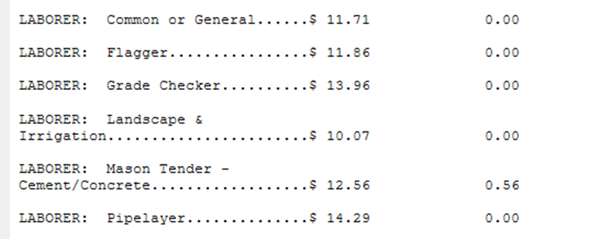
Statement of Compliance
C.C.M.
6.5.15
Reporting Payment of Fringe Benefits on Statement of Compliance continued….
DO NOT mark both boxes!
NO box needs to be checked is there is NO fringe benefit required on the WD for the work classifications reported on the pay record = wage rate is paid fully in cash
CCCA Field Office Review:
Section V: Wages
L6

Slide 125
Statement of Compliance
From the full weekly wages earned by any person and that no deductions have been made either directly or indirectly from the full wages earned by any person, other than the permissible deductions as defined in Regulations, Part 3 (29 CFR Subtitle A), issued by the Secretary of Labor under the Copeland Act, as amended (48 Stat. 948, 63 Stat. 108, 72 Stat. 357, 40 U.S.C. 3145), and described below:
Either note-see payroll attached
OR
List each deduction by employee, type, and dollar amount

Slide 126
Wage and Hour Record
CCCA Field Office Review:
Section V: Wages
L7

Slide 127
Deduction Record
CCCA Field Office Review:
Section V: Wages
M1

Slide 128
Notice of Noncompliance
C.C.M.
6.6.2
Violation Types
(1) Issue “Notice of Noncompliance” letter when:
Contractor/Subcontractor active on project and failed to submit a certified payroll for that week (A copy of the Daily Work Report may be attached as reference) by due date (7 days after pay date)
The certified payroll record is not received within 7 days of that company’s regular payment day of the payroll period
Statement of Compliance is incomplete or incorrect
CCCA Field Office Review:
Section V: Wages
N1-N6

Slide 129
Notification of Payroll Violation
C.C.M.
6.6.2
Payroll Violation (FDOT Form No. 700-010-59)
(2) Issue “Notification of Payroll Violation” when:
All other noncompliance items found on payrolls
Issued by RCS when payroll does not comply with minimum wage requirements
Phone calls SHALL NOT be placed in lieu of issuance of this form; may be placed in addition to
Issued ANY day of the month
Local Agency RCS → Prime Contractor (copy DCCM)
CCCA Field Office Review:
Section V: Wages
N1-N6

Slide 130
Payroll Violations
C.C.M.
6.6.3
Supplemental (corrected) payroll DUE in 20 calendar days
Proof of payment and employee receipt (bank cleared check or direct deposit pay stub)
Reminder: Redact personal and confidential information as needed
If contractor cannot contact affected employee, payment must then be sent to USDOL Wage and Hour Division (WHD)
CCCA Field Office Review:
Section V: Wages
N1-N6

Slide 131
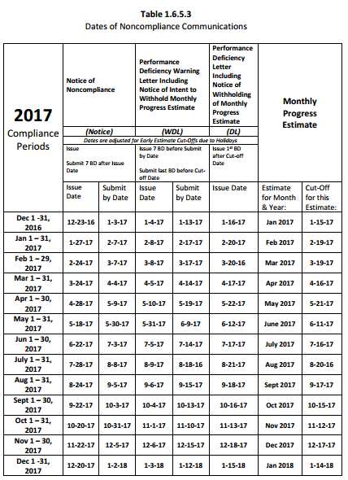
Payroll Violations
C.C.M.
6.6.3
Table 1.6.5.3 “Dates for Noncompliance Communications” identifies the standard issuance and documentation due dates for each level of noncompliance communication.

Slide 132
2:30 – 2:45

Slide 133
Fringe Benefits
C.C.M.
6.8.1
Under Davis Bacon Act, monetary wages paid in excess of the specified “Rate” may be used to offset or credit to satisfy fringe benefit obligations
Likewise, excess Fringe benefits may be used to satisfy the specified “Rate” provided the governmental minimum wage is honored in cash ($8.05)
Where excess fringe benefits are used to offset the Rate, an employee’s overtime pay of time-and-a half must be based on at least the “Rate” specified
When reporting fringe on the Statement of Compliance you will check either box 4(a) or 4(b). If no fringe is required, the boxes may be left unmarked

Slide 134
Fringe Benefits
C.C.M.
6.8.1
Fringe Benefits that exceed the fringe benefit limit on the WD and require part of the minimum base rate listed on the WD to be used, are considered to be part of the employees minimum base rate in meeting the prevailing wage. Bona Fide fringe benefits do not require the approval of USDOL if they exceed the limit of fringe benefits on the WD and require cutting into the minimum base rate on the WD the employees approval is not required, but the plan must be communicated to the employee in writing
CCCA Field Office Review:
Section V: Wages
L12

Slide 135
Fringe Benefits
C.C.M.
6.8.1
If they exceed the limit of fringe benefits on the Wage Decision and require cutting into the minimum base rate on the Wage Decision, the employee’s approval is not required, but the plan must be communicated to the employee in writing. The employee should be allowed to opt out of any fringe in which they would be termed ineligible or that is a deduction to the base rate on the Wage Decision
CCCA Field Office Review:
Section V: Wages
L12

Slide 136
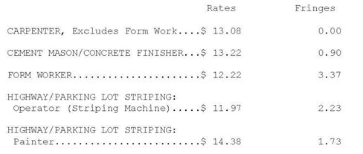
Fringe Benefits
C.C.M.
6.8.1
A wage decision may state a fringe benefit requirement specific to a classification
Form Worker: $12.22 (Cash rate) + $3.37 (Fringe Benefits)
Contractors may meet the total requirement by paying combinations of cash and bona fide fringe benefits:
(1) Pay SUM in CASH
(2) Pay CASH and “bona fide” fringe benefits
(3) Some combination of the above
CCCA Field Office Review:
Section V: Wages
L12

Slide 137
Fringe Benefits
C.C.M.
6.8.2
CCCA Field Office Review:
Section V: Wages
L12

Slide 138
Fringe Benefits
C.C.M.
6.8.3
Work Hour and Overtime Requirements:
Where a Wage Determination specifies “Rate” and “Fringe, fringe benefits must be paid for all hours worked, including overtime
Fringe amounts may be excluded from the half-time (x0.5) premium for overtime; fringe may be paid at the straight rate (versus the time-and-a-half rate) for overtime hours (x1.0)
Cash payments made to meet a required wage determination fringe benefit amount are excluded from the half-time (x0.5) premium for overtime; cash payment of fringe benefit requirements are paid at the rate of (x1.0) for each overtime hour
CCCA Field Office Review:
Section V: Wages
L12

Slide 139
Fringe Benefits
C.C.M.
6.8.3
Alternative #1 - Contractor pays Rate and Fringe in cash only; no bona fide fringe benefits are involved. Overtime must be paid at 1.5x the sum of the cash rate and fringe
Cement Mason works 44 hours

Slide 140
Fringe Benefits
C.C.M.
6.8.3
Alternative #2 - Contractor pays Rate in cash and Fringe in bona fide benefits. Only the Rate is subject to 1.5x premium and the Fringe is paid at 1.0x for overtime
Cement Mason works 44 hours

Slide 141
Fringe Benefits
C.C.M.
6.8.3
Alternative #3 - Contractor pays cash at lower than the specified Rate and pays Fringes greater than specified. The 0.5x overtime premium is paid 0.5x the specified Rate
Cement Mason works 44 hours

Slide 142
Bona Fide Fringe Benefits
C.C.M.
6.8.4
Two (2) types of Bona Fide Fringe Benefits:
1. Funded Benefit Plans (Ex. Insurance, Pension, 401k)
2. Unfunded Benefit Plans (Ex. Vacation, Holiday, Sick Leave)
Fringe Benefit Calculations shall be requested to verify the fringe hourly amount reported to meet the PWR. RCS needs to not only verify the amount but whether the benefit report is a bona fide fringe benefit
Example: Sick Leave hours being credited but by review of the employee handbook, is not paid out to the employee for hours unused upon termination of employment
CCCA Field Office Review:
Section V: Wages
L12

Slide 143
Unfunded Benefit Plan Calculations
C.C.M.
6.8.4.2
Monies are not paid by the Contractor to a third party; rather the benefit is paid by the Contractor as the benefit is earned
Fringe contribution varies based on employee’s actual hourly rate of pay
Example: 40 hours paid vacation for two different employees who work 2080 hours per year
Employee A: Actual rate of pay = $10.00/hr
Per hour fringe benefit contribution = $.19 ($10.00/hr x 40 hours / 2080 hours)
Employee B: Actual rate of pay = $15.00/hr
Per hour fringe benefit contribution = $.29 ($15.00/hr x 40 hours / 2080 hours)
CCCA Field Office Review:
Section V: Wages
L12

Slide 144
Funded Benefit Plan Calculations
C.C.M.
6.8.4.1
Contractor payments to a fund, plan or program where payments are made irrevocably to a trustee or a third party
“Annualization” – Contributions made are allowed based on the effective annual rate of contributions for all hours worked during the year by the employee
Example: Contractor pays medical insurance premium on behalf of employee with an hourly value of $1.15
Monthly premium = $200/month = $2400/year ($200 x 12 months) Employee’s annual hours worked = 2080 (52 weeks x 40 hours/week) hourly insurance premium contribution = $1.15 per hour
($2400 annual premium/2080 annual hours)
CCCA Field Office Review:
Section V: Wages
L12

Slide 145
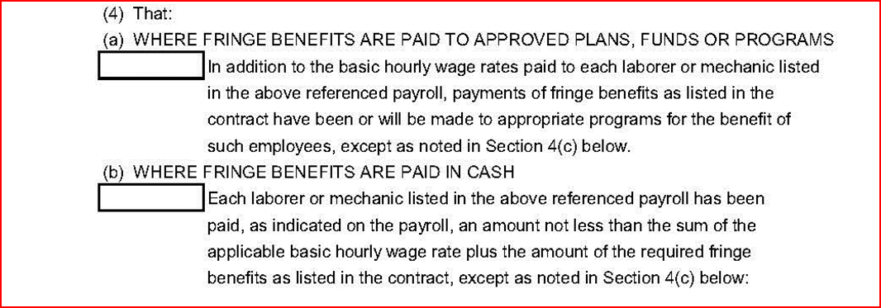
Reporting Payment of Fringe Benefits
C.C.M.
6.8.6
CCCA Field Office Review:
Section V: Wages
L12

Slide 146
Reporting Payment of Fringe Benefits
C.C.M.
6.8.6
CCCA Field Office Review:
Section V: Wages
L12

Slide 147
Reporting Payment of Fringe Benefits

Slide 148
Most Common Certified Payroll Errors
Statement of Compliance (slide #122)
Missing deductions noted (at 4 lines) – place “See attached payroll”
Contract # or Fin. # not listed at “Building or Work”
Signature doesn’t match signor designee
Full date of pay period is incomplete
Item 4(a/b/c) marked inaccurately
Wage and Hour Record (slide #123)
Reporting unavailable wage classifications
Reporting project gross as weekly gross
“Other” deductions not being reported
Weekly pay period dates don’t match
Contract # or Fin. # not reported or reported inaccurately

Slide 149
Payroll Exercise

Slide 150
Best Practices
Review daily field reports each week for prior weeks work
Maintain files individually per Contractor
Maintain tracking sheets for all areas: EEO, DBE, Wages, OJT
Review weekly payrolls as received
Review FIRST payroll thoroughly and VERY closely
Ensure field staff has templates of all forms
Send reminders to field staff on monthly items needed:
Interviews
CUFs
Trucking Observations
Utilize deficiency communications for items to be resolved timely

Slide 151
LA Faces / Workshop Solutions
Local Agency Faces
Time
Manpower
Workshop Intent
Organization and Electronic processing
TEAM Effort
Resources
Established Process
Forms and resources offered
D7 Compliance Support
Best use of time with assistance available as needed
FDOT provides Tracking Tools and processes shared
Lack of:

Slide 152
Project Monitoring Flow Chart

Slide 153
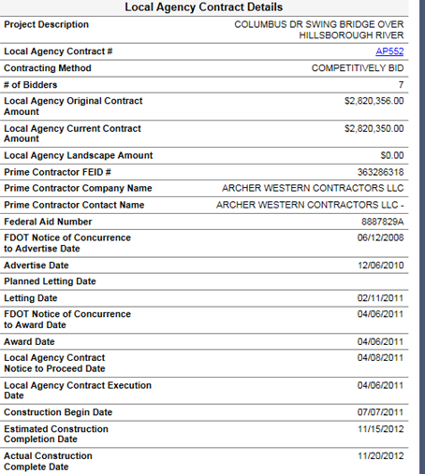
Construction Contract in LAPIT

Slide 154
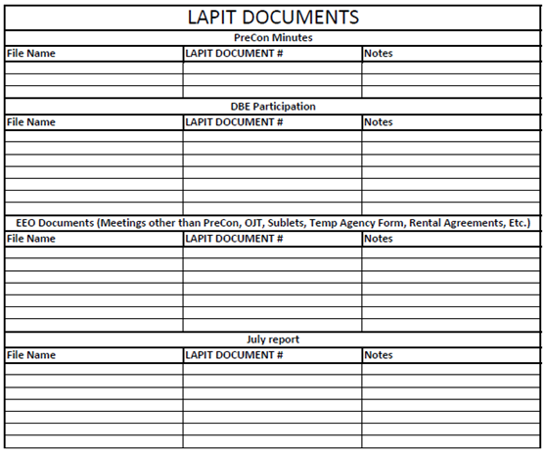
Documents Needed in LAPIT
PreCon Meeting Minutes
DBE Participation
Meetings
OJT
Sublets
Temporary Agency Form
Rental Agreement
July Report

Slide 155
Your attendance is appreciated
Please pick up your completion certificate before you leave!

