Slide 1
EDMS Batch Export
For use with the Final Estimates Transmittal Form, 700-050-20 to document the EDMS numbers applicable to the Final Estimates Package

Slide 2
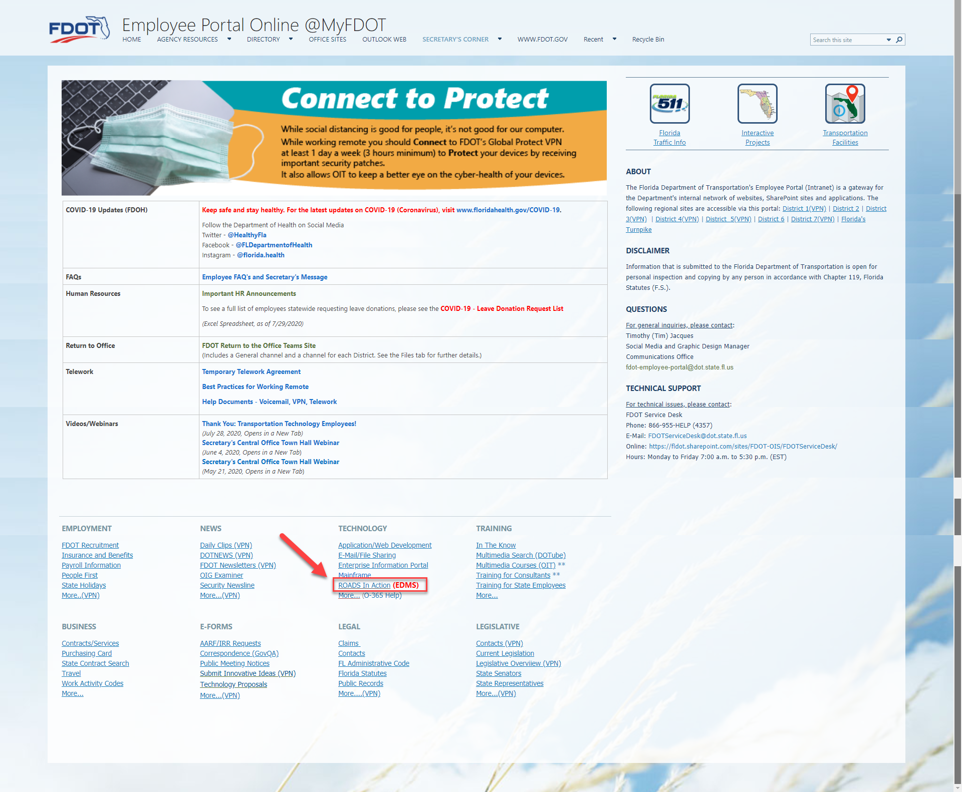
From Infonet, click ROADS In Action (EDMS)

Slide 3
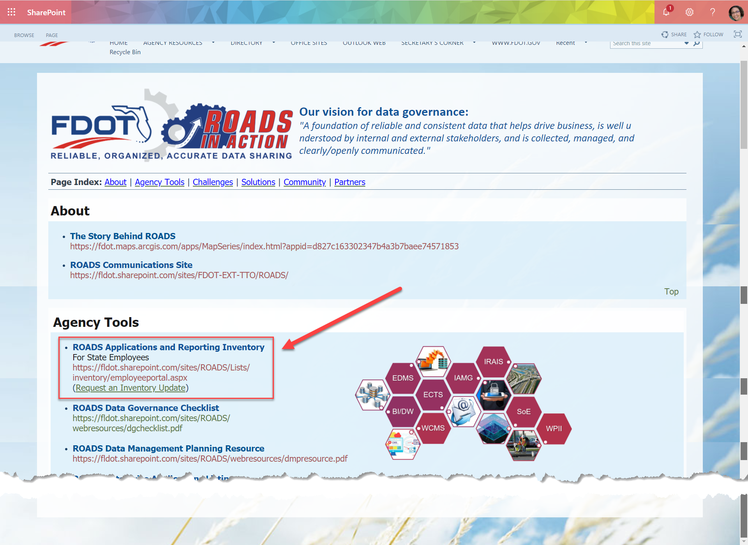
Next, select ROADS Application and Reporting Inventory

Slide 4
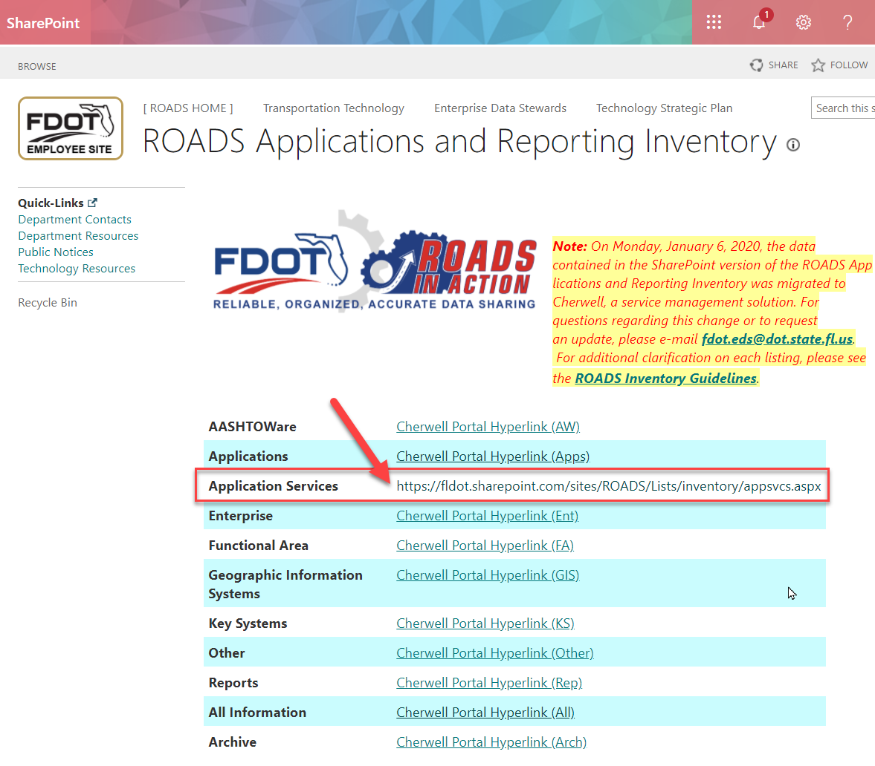
Next, select the link for Application Services

Slide 5
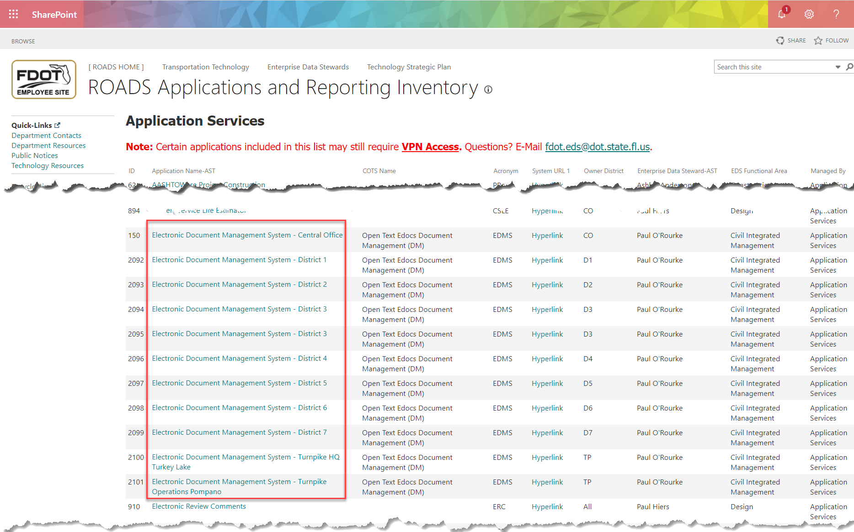
Select any of the EDMS links

Slide 6
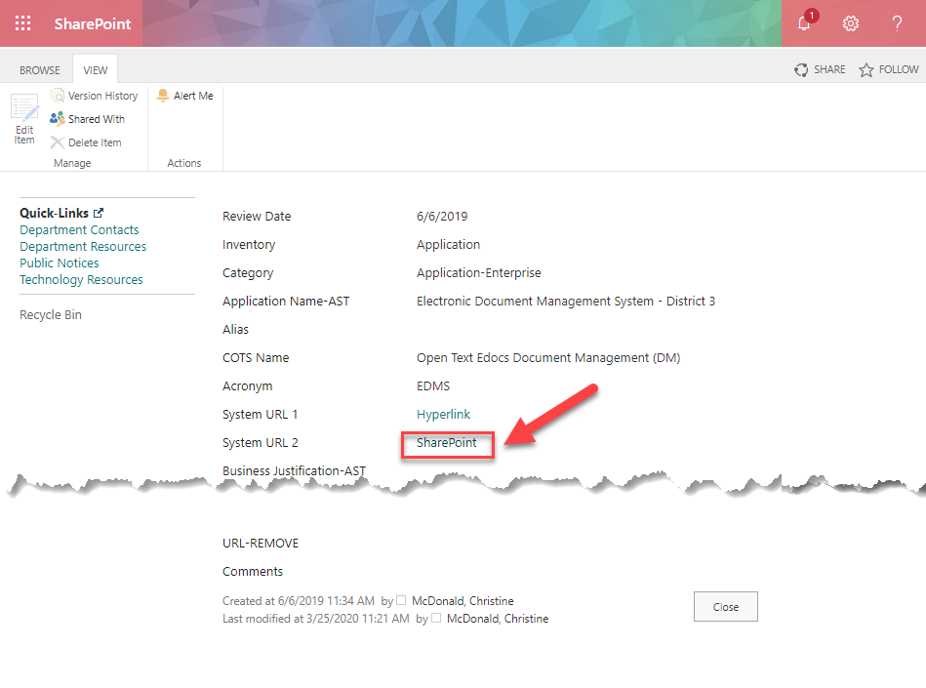
Select the URL to SharePoint

Slide 7
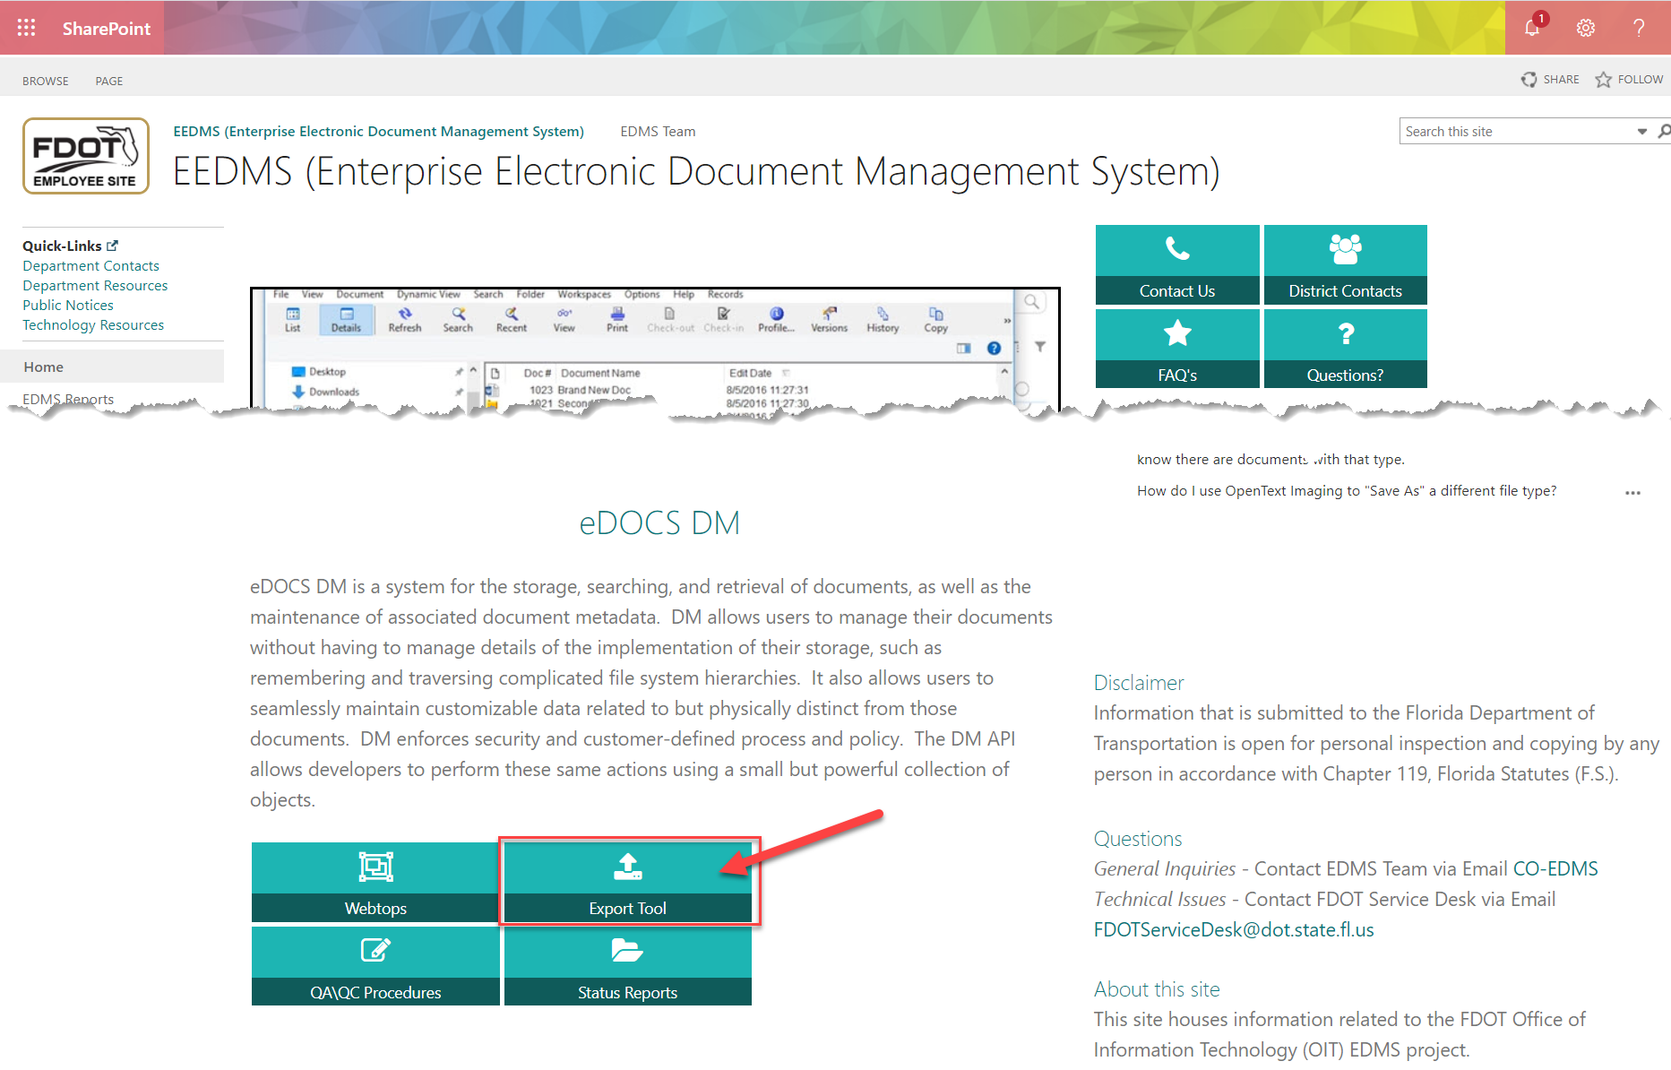
Scroll down to select Export Tool

Slide 8
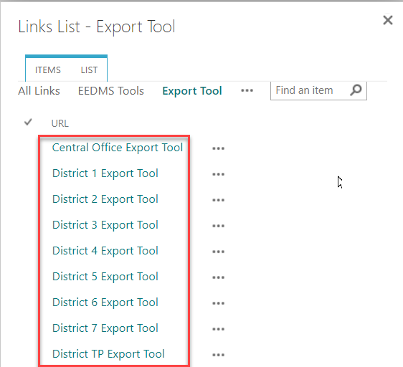
Select the Export Tool for your District

Slide 9
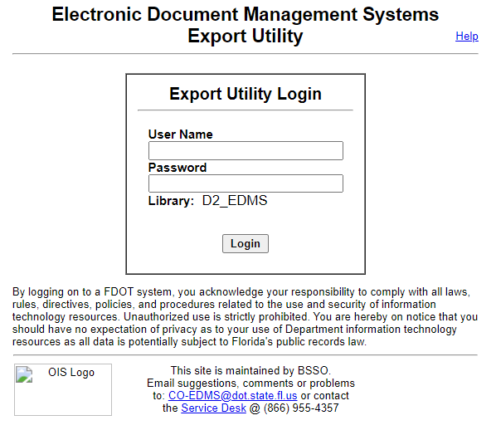
Login to the Export Utility Consultants use Citrix credentials

Slide 10
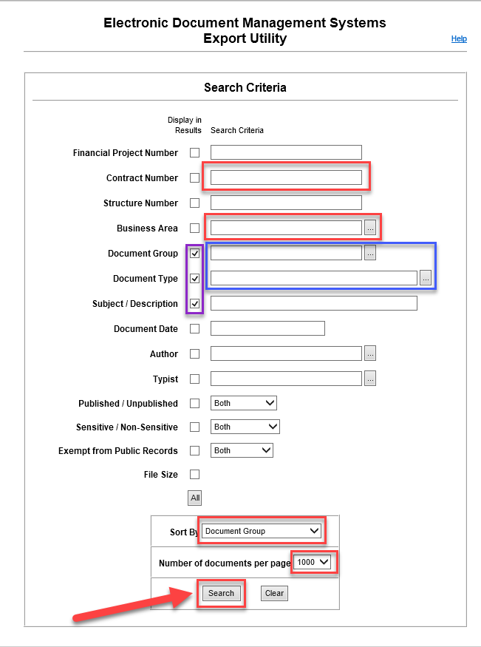
Recommended Search Criteria
Enter your Contract Number
Select Construction for Business Area
In the Display in Results column, place checkmarks next to Document Group, Document Type, and Subject Description
Search Options:
For expanded search, select the applicable Document Groups
For refined search, select the applicable Document Types
Enter a filter for Business Area, Construction, then Apply.
Click Document Group to sort the list:
Select to sort by Document Group
Select to list 1000 documents per page

Slide 11
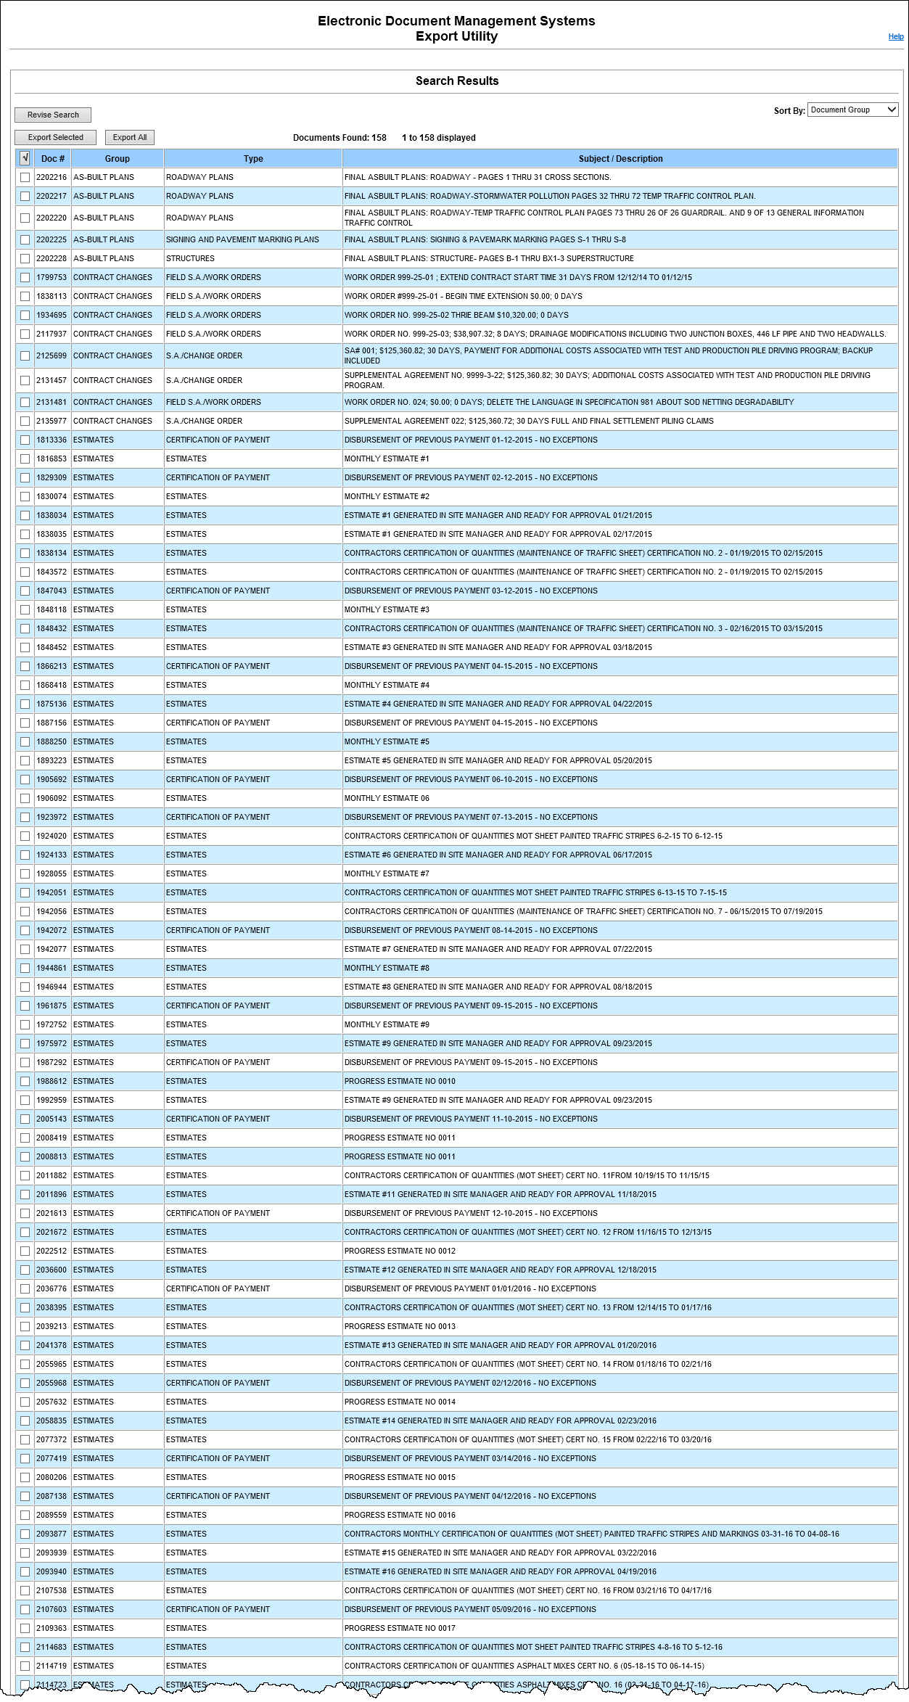
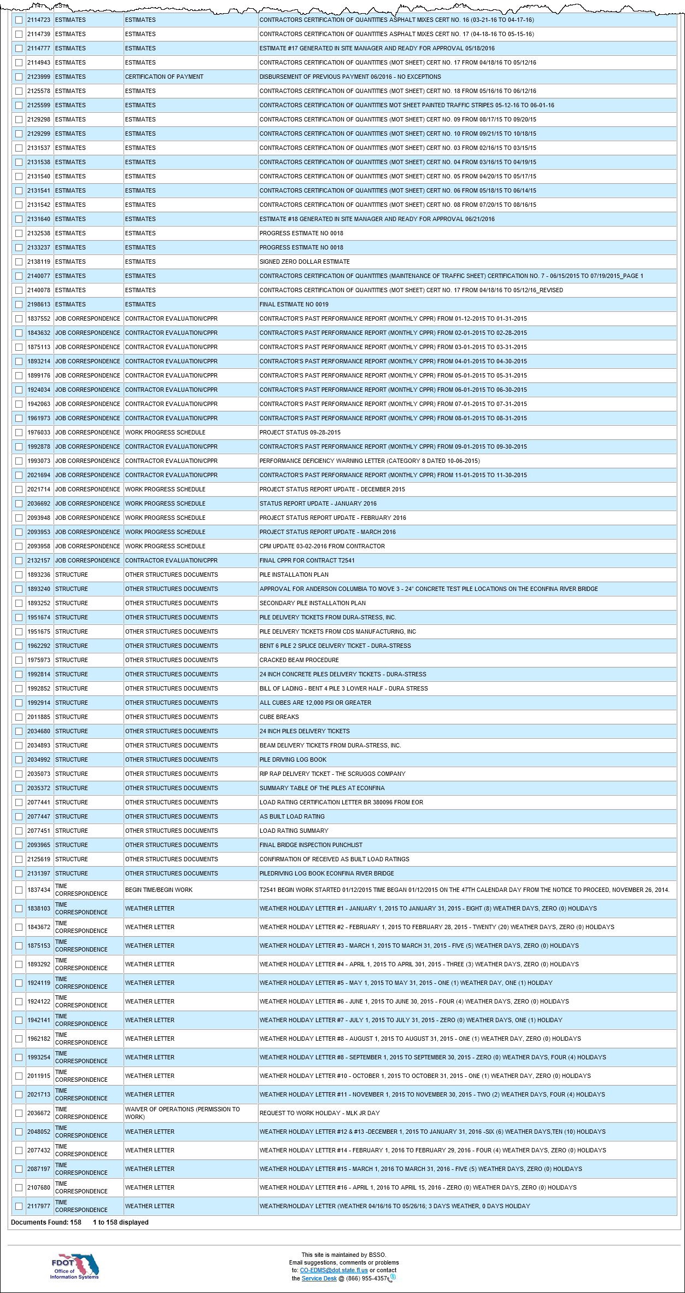
Verify all documents in question shown in the displayed list Using the list of Document Types on the Final Estimate Transmittal, 158 results were displayed for this example contract.

Slide 12
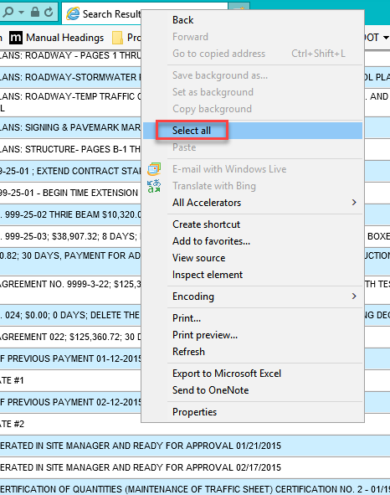
Right click on the screen, click Select All or press Ctrl + A

Slide 13
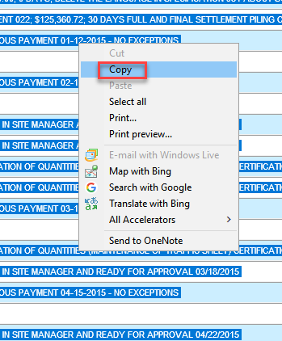
Right click on the screen, click Copy or press Ctrl+C

Slide 14
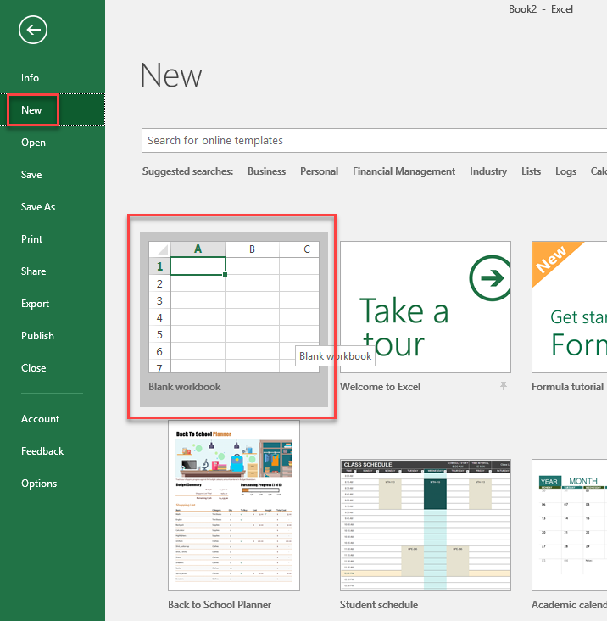
Open a blank Excel workbook

Slide 15
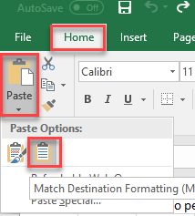
Under Home, select Paste, then select Match Destination Formatting

Slide 16
The following are instructions for formatting the results in Excel based on the Recommended Search Criteria
(If you choose different search criteria, the instructions may not correspond to your results.)

Slide 17
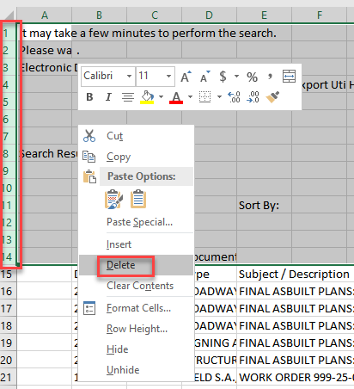
Highlight the first 14 rows (the rows above the headings Doc#/Group/Type), then right click and select Delete

Slide 18
Highlight column A (its blank), right click and select Delete

Slide 19
Select View, then select Page Break Preview

Slide 20
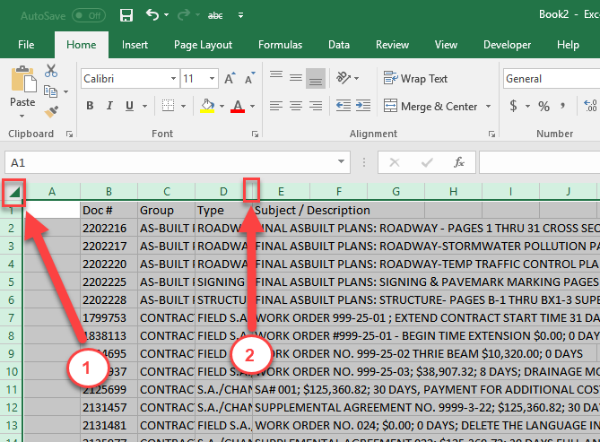
Select the corner, then double click between column D and E

Slide 21
Select Page Layout, then select 1 page under Width

Slide 22
Select Page Layout, then select 1 page under Width

Slide 23
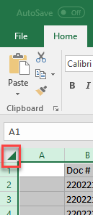
Select all text(corner click), then select Data, then select Filter

Slide 24
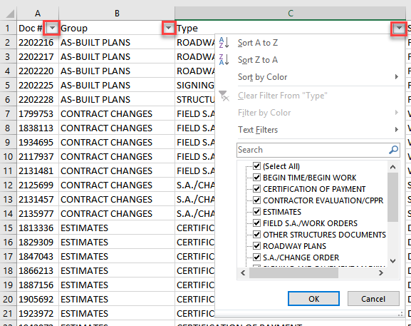
The drop down box added to each column can be used to filter information as needed.

Slide 25
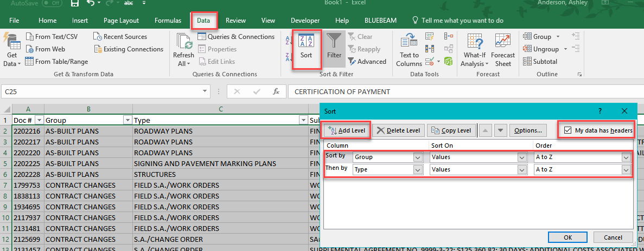
Select Data, then select Sort. Place a check for My data has headers, then enter 2 Levels as shown for Group and Type, then select OK.

Slide 26
Save and submit this spreadsheet to your DFEM with the Final Estimates Transmittal in lieu of listing Document numbers

