Slide 1
CADD Manager's Series
Site Integration

Slide 2
Learning Objectives
Upon completion attendees will:
Know what Environment Variables and Registry Values are set during installation.
Understand how FDOT configuration files work together to define the workspace.
Know where and how to define site specific variables.

Slide 3
Installation Types
Client\Server
Stand-Alone Workstation
Intended for all installations where a consistent network connection is available.
Easy to update and manage many computers at once.
Very few files deployed to client machine.
.NET Configuration Required.
Intended for laptops, field office, or other locations where network connection is not always available or slow.
Combines Server and Client into a single install.
Nearly 10,000 files, just under 500mb.
.NET Configuration Not Required

Slide 4
Installation Guide
The installation guide provides vital information needed when planning to deploy a new workspace.
System Requirements
Version Numbers
.NET Instructions
Silent Install Instructions
Screenshots and instructions of example installations

Slide 5
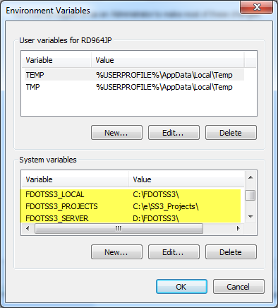
Installation Details
Icons are dependent on specific versions of MicroStation\GEOPAK or PowerGEOPAK.
Environment Variables
Registry Values
Also described in ReadMe file.

Slide 6
Updating Clients for New or Renamed Server
Reinstall Clients
Update FDOTSS3_SERVER Environment Variable and Registry values.
Make sure to include training backslash.
GEOPAK properties may need to be updates or resource files may need to be deleted because some store paths.
User Preferences
Project Manager
Corridor Modeler

Slide 7
FDOT Configuration File Order
The FDOT workspace configuration files are processed in the following order:
FDOTSS3 Icon
Defines the _USTN_USER variable redirecting where MicroStation finds UCF files.
FDOTSS2.ucf
Defines User (machine) specific variables and call all remaining config files in order.
CustomVars.txt
Optional file (not delivered) used that can be used by CADD Managers to add to or overwrite variables.
Sitefdot.txt
Discipline text file
Defines variables common to all disciplines
Defines discipline specific variables.

Slide 8
FDOTSS3 Icon
The FDOTSS3 Icon is technical a config file because it is defining MicroStation configuration variables.
Target Property:
"C:\Program Files (x86)\Bentley\PowerGEOPAK V8i (SELECTSeries 3)\PowerGEOPAK\PowerGEOPAK.exe" -WS_USTN_USER=C:\FDOTSS3\workspace\users\ -wuFDOTSS3
ProjectWise users can add the following variable to the end of the Target Property if they do not use ProjectWise with FDOT projects:
-WSPW_DISABLE_INTEGRATION_FROM_DESKTOP=1

Slide 9
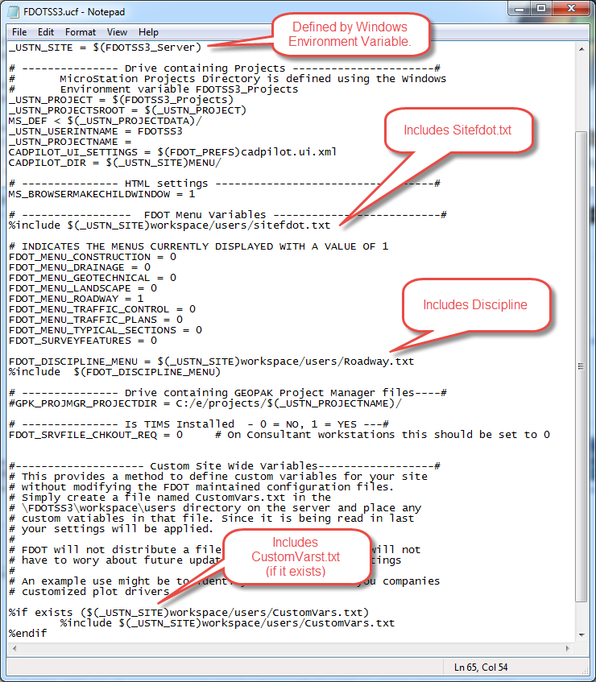
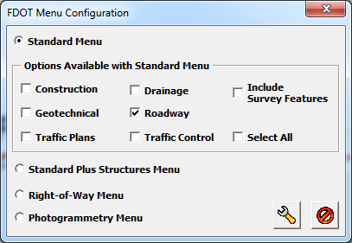
FDOTSS3.UCF
The UCF file is located in the local \FDOTSS3\Workspace\Users directory.
Users must have Write access.
The UCF file is dynamically updated by MicroStation and the FDOT Menu Configuration tool.

Slide 10
Sitefdot.txt
The Sitefdot.txt file defines variables common to all users.
The Sitefdot.txt file should never be modified.
Will be overwritten by future MRs.

Slide 11
Discipline.txt
The <Discipline>.txt files define variables unique to a specific discipline.
Roadway.txt
RightOfWay.txt
Structures.txt
The <Discipline>.txt files should never be modified.
Will be overwritten by future MRs.

Slide 12
CustomVars.txt
The CustomVars.txt file is intended for use by CADD Managers. It is not delivered with FDOT workspaces so it will not be overwritten by Maintenance Releases (MRs).
Must be created in the \FDOTSS3\Workspace\Users directory on the server.
Used to define variables unique to a specific office or company.
Cell Libraries
Toolboxes, Interface Customization
Styles (Text, Dimension, Print)
Project\Discipline Subdirectories
(i.e. <FPID>\Roadway\GEOPAK)

Slide 13
Commonly Updated Variables
MS_DGNLIBLIST > $(ENGCORP_ROOT)/ENGCORP_Interface.dgnlib
Used to include new DGNLIB
MS_TEXT_FAVORITESYMBOLFILE > $(FDOTSS3_LOCAL)Workspace/prefs/FavoriteSymbols.xml
Used to define a list symbols for quick access in the text editor.
MS_CELL
Search path(s) for cell libraries.
MS_CELLLIST > $(ENGCORP_ROOT)/cells/EOR.cel
List of cell libraries to be searched for cells not found in the current library.
MS_IDLETIMEOUT = 90
Specifies the number of minutes of inactivity before MicroStation closes.
MS_FKEYMNU = $(FDOTSS3_SERVER)Workspace/Interfaces/Fkeys/Bentley-Civil.mnu MS_BUTTONMENU
Defines the function key assignments.
MS_PENTABLE = $(_USTN_SITE)RESOURCES/plot/ MS_PLTCFG_PATH
Defines the search path for pen tables.
http://communities.bentley.com/products/microstation/w/microstation__wiki/4176.microstation-v8i-variables.aspx

Slide 14
Configuration Variable File Syntax
Configuration variable files are text files that consist of a series of lines. Each line contains a configuration variable name and definition in the following syntax:
<VARIABLENAME> <operator> <new_value> # comment
Variable names can contain only alphanumeric characters (A-Z, 0-9) and the _ (underscore). They must be at least two characters.
Anything after a number sign (#) on a line is treated as a comment and is ignored.
File path names should be entered using the forward slash (/). Windows converts all forward slashes (/) in new_value to backslashes (\). Also, all directory definitions should end with a trailing forward slash.
When editing a configuration variable file, insert a carriage return at the end of the last line to ensure the entire file will be processed. Press <Enter> to insert a carriage return.

Slide 15
Operators
Operators control how or in what order the value of a variable is applied.

Slide 16
Preprocessor Directives
Conditions can be applied to variables using “Preprocessor Directives”.
Preprocessor directives always begin with %. The following preprocessor directives are available:

Slide 17
Example Preprocessor Directives
Conditional on the value of a variable:
Conditional on a files existence:
Conditional on Windows Username:
%if $(FDOT_MENU_TRAFFIC_PLANS) == 1
MS_CELL = $(ENGCORP_ROOT)Cells/
MS_CELLLIST < $(ENGCORP_ROOT)Cells/SpecialSigns.cel
%endif
%if exists ($(_USTN_SITE)workspace/users/CustomVars.txt)
%include $(_USTN_SITE)workspace/users/CustomVars.txt
%endif
# Include function key and button menus based on user's login
%if $(USERNAME) == "RD964JP" # Case Sensitive- Use Uppercase
MS_FKEYMNU = $(ENGCORP_ROOT)users/$(USERNAME)/$(USERNAME).mnu
MS_BUTTONMENU = $(ENGCORP_ROOT)users/$(USERNAME)/$(USERNAME).btnmenu
%endif

Slide 18
Directives
By using “Directives”, you can define your variables so they more readily rely on the definitions of other variables, including using bits and pieces of other variables to construct, or build ( ), a new configuration variable.
AskInga Article #287
http://communities.bentley.com/communities/other_communities/askinga/w/askinga/microstation-j-enhanced-workspace-functionality.aspx

Slide 19
Restore the Defaults with a Command Line Switch
To quickly restore the default settings of your installation of MicroStation V8 XM Edition or V8i, use the “-restoredefaults” command line switch.
In doing so, the following folders will be cleaned:
Deleted C:\Users\user.name\AppData\Local\Bentley\MicroStation\8.11\xxxxxxxxxxxxxxxxxxx
Deleted C:\Users\user.name\AppData\Roaming\Bentley\MicroStation
Deleted C:\ProgramData\Bentley\MicroStation
Deleted C:\Users\user.name\AppData\Local\Temp\Bentley\MicroStation\8.11
Defaults restored. Press any key to exit.
AskInga Tip #617
http://communities.bentley.com/communities/other_communities/askinga/w/askinga/quickly-restore-the-defaults-with-a-command-line-switch.aspx

Slide 20
Expand Set
Used to define a configuration variable and set its value. Using this key-in is an alternative to the Configuration dialog (Workspace > Configuration).
Key in EXPAND SET <configuration_variable> = <configuration_variable_value>.
A configuration variable defined using EXPAND SET remains defined only for the remainder of the current session.
To specify a configuration variable definition and at the same time save it in the user configuration variable for reference in subsequent sessions, use the EXPAND SETSAVE key-in

Slide 21
Expand Echo
The Expand Echo command is used to display the value of a configuration variable in the Message Center. Using this key-in is an alternative to the Configuration dialog (Workspace > Configuration).
Key in: EXPAND ECHO $(<configuration_variable>).
If the specified configuration variable is defined, it is displayed in the Message Center field of the status bar.

Slide 22
FDOTConfig
FDOTConfig is an application that runs when the FDOT workspace starts to dynamically populate the MS_RFDIR value.
It locates the root of the project by searching for a _meta_info directory in the current working directory and each directory in the path until it finds the _meta_info directory, which should be located in the root of the FDOT project directory structure. It then adds the subdirectories of the project to the MS_RFDIR value.
Discipline folders are added before lower level folders.
Subdirectories can be ignored and not added to the MS_RFDIR value if defined in a FdotConfig.xml located in the root of the project.
This can be useful when working with alternate designs.

Slide 23
FdotConfig.xml
Copy the FdotConfig.xml from the \FDOTSS3\mdlapps directory into the root of your project.
Copy and paste additional “folder” line(s) then modify as needed

Slide 24
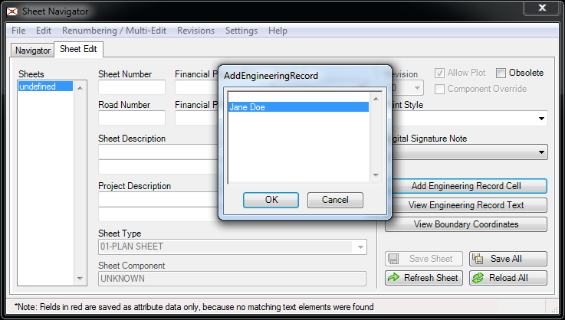
Sheet Navigator
Sheet Navigator can be customized to site or project specific settings.
EOR Cells
Ignored Files and Directories

Slide 25
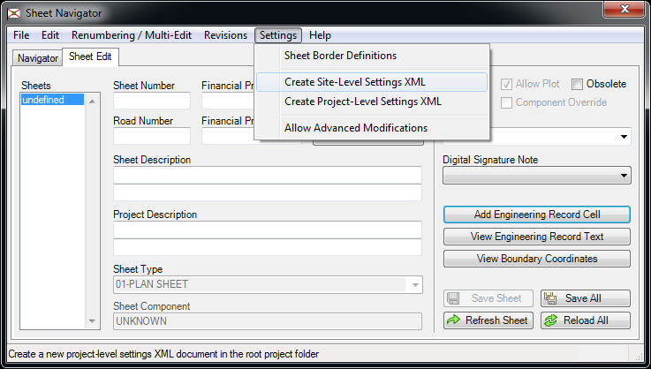
Site-Level Settings XML
Choose “Settings > Create Site-Level Settings XML” from the menu to create an initial XML file
Sheetinfo_Settings.XML is created in the \FDOTSS3\mdlapps directory on the server.
Note: The Project-Level Settings XML file is named Sheetinfo_Settings.XML and is located in the root of the project.

Slide 26
Editing Site-Level Settings XML
There are two major tags to control how data is processed
MergeSettings – Include custom data with FDOT data
OverrideSettings – Replaces FDOT data with custom data
Data can be copied from same location in SheetInfo.xml and modified.

Slide 27
Contact Information
Jimmie Prow CADD Applications Support Coordinator Phone no: (850) 414-4863 Toll Free no: (866) 374-3368 extension 4863
Florida Department of Transportation Engineering / CADD Systems Office 605 Suwannee Street, Mail Station 69 Tallahassee, Florida 32399-0450
email ecso.support@dot.state.fl.us
jimmie.prow@dot.state.fl.us
web: http://www.dot.state.fl.us/ecso

