Slide 1
CADD Manager's Series
Printing

Slide 2
Topics Covered
Printing Configuration Variables
Print Drivers
Pen Tables
Print Styles
Print Organizer
Sheet Navigator

Slide 3
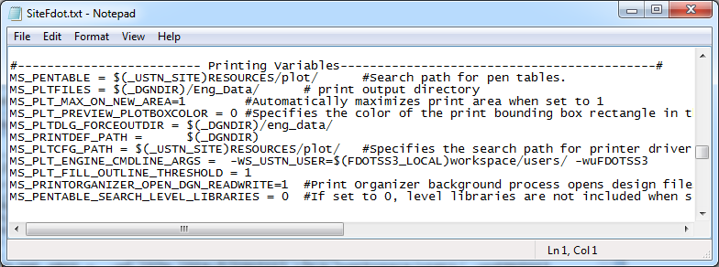
FDOT’s Printing Variables
FDOT’s printing related variables are defined in the Sitefdot.txt file.
See MicroStation help for a complete list of printing variables.

Slide 4
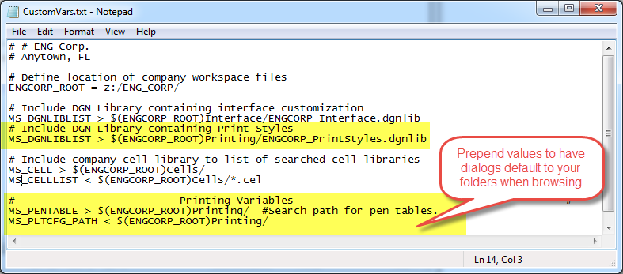
Customizing Printing Variables
If you have your own library of print drivers and pen tables you can configure the workspace to use them by default instead of the FDOT files.
Prepend your path using the “<“ character and your path will be the default folder opened when browsing for pen tables or print drivers.

Slide 5
Printing Considerations
What should be done to maximize printing efficiency?
Customize postscript drivers.
Postscript preferred for automatic scale selection.
Create one for each printer or provide a way to automate printer selection.
Develop pen table library.
Identify preferences for each discipline and create pen tables.
References, weights, and grayscale preferences.
Configure Print Styles
Create Print Styles for commonly used printing properties

Slide 6
Print Drivers
Postscript | System Drivers | HPGLRTL | PDF
hp5000.pltcfg | fdotprinter.pltcfg | hpglrtl.pltcfg | FDOTPDF.pltcfg
hp1055.pltcfg |  | hpglrtl_c.pltcfg | Color_FDOTPDF.pltcfg
hp1055c.pltcfg
All of the FDOT provided drivers are capable of printing raster. If your image is not printing check the level the image is on to ensure it is not a non-plotting level.

Slide 7
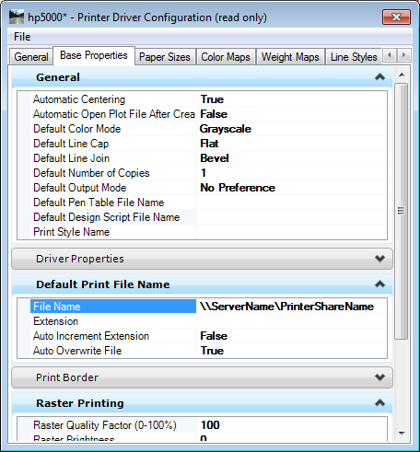
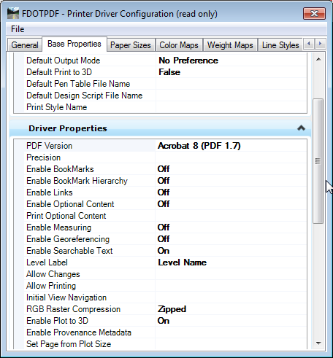
Editing Drivers
Postscript
PDF
Postscript drivers require you to define an output device
Shared Printer:
\\SERVER\PRINTER
Port: LPT3
PDF drivers have many enhanced functions that are turned off by default to increase speed.
PDF driver is the only type that can print “Transparency” without using the Rasterized option

Slide 8
Pen Tables
Pen Tables are a very effective method of customizing printed output.
Modify anything from an entire file to a single element.
Turn elements off.
Change the symbology.
Color
Weight
Style
Change the priority so elements are always printed on to or below other.

Slide 9
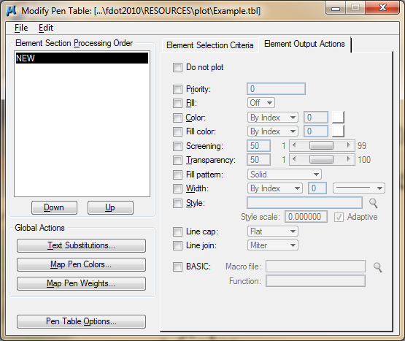
Pen Tables Are Easy
Editing a pen table is very easy. It has 3 basic steps.
Insert a Section
Define Selection Criteria
Define Output Actions
It’s like creating a selection set and changing symbology for prints.

Slide 10
Print Styles
Print Styles allow you to define and reuse collections of print properties.
Paper Size
Pen Table
Plot Driver
Fence Definitions (plot border)
They can be used in both Print Organizer and the Print dialog.

Slide 11
Where are Print Styles Stored?
Print Styles are stored in DGN Library (DGNLIB) files.
In the FDOT workspace the default styles, are stored on the server in FDOT_PrintStyles.dgnlib.
Site specific Print Styles can be stored in a file named Custom_PrintStyles.dgnlib in the FDOTSS3\RESOURCES\Dgnlibs directory on the server.
User specific Print Styles can be stored in a file named USER_PrintStyles.dgnlib in the local \FDOTSS3\Workspace/prefs/ directory.
Project specific Print Styles can be stored in the symb directory.
Any other location can be defined in the CustomVars.txt by adding the file containing your print styles to the MS_DGNLIBLIST variable.

Slide 12
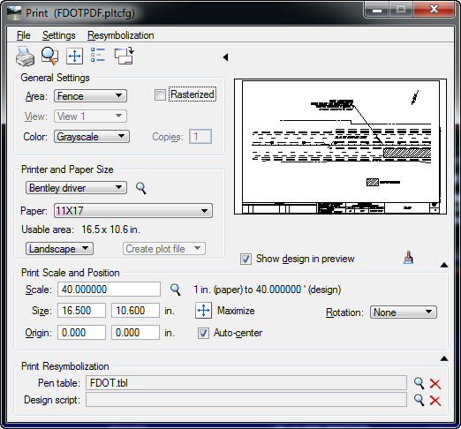
Single Sheet Printing
Select “Settings > Apply Print Style” to quickly apply all settings, including the fence.
Keyin: print style <Style Name>
Dialog was updated to include Pen Table field.
Now supports (InterPlot) Design Scripts

Slide 13
Using Print Styles in Print Dialog
There are many benefits to using Print Styles in the single sheet Print dialog.
No need to place a fence.
No need to select a plot driver.
No need to select a pen tables.
No need to adjust display settings.
Once a Style has been applied you can override settings if needed

Slide 14
Using Print Styles in Print Dialog
Select “Settings > Apply Print Style” to quickly apply all settings, including the fence.
There are many benefits to using Print Styles in the single sheet Print dialog.
No need to place a fence.
No need to select a plot driver.
No need to select a pen tables.
No need to adjust display settings.
Once a Style has been applied you can override settings if needed

Slide 15
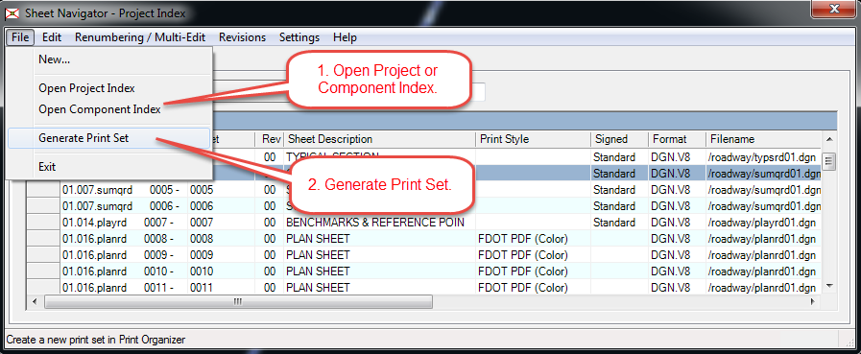
Sheet Navigator
Sheet Navigator can generate Print Organizer PSETs from the Project Index.

Slide 16
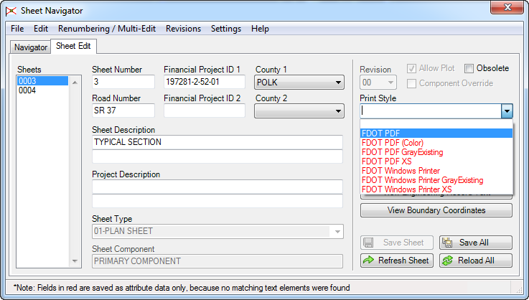
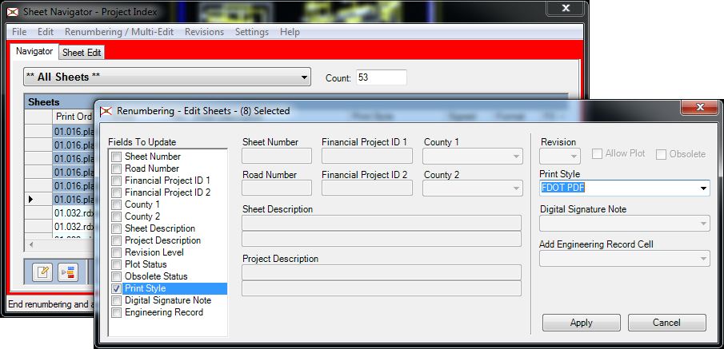
Sheet Navigator – Print Styles
Print Styles can be applied in the Sheet Edit tab or by using the Multi-Edit process.
If no Print Style is defined a default style is applied.
Default style is defined in the SheetInfo.pset located in the \FDOTSS3\mdlapps directory.

Slide 17
Contact Information
Jimmie Prow CADD Applications Support Coordinator Phone no: (850) 414-4863 Toll Free no: (866) 374-3368 extension 4863
Florida Department of Transportation Engineering / CADD Systems Office 605 Suwannee Street, Mail Station 69 Tallahassee, Florida 32399-0450
email ecso.support@dot.state.fl.us
jimmie.prow@dot.state.fl.us
web: http://www.dot.state.fl.us/ecso

